Slide 1
Corporate Presentation
Communications, Brand and Public Affairs Department

Slide 2
Group FCC
Aqualia
Key figures
Diversified business model
Position of leadership in all areas
International presence
Integrated offering
Value creation
Corporate Governance Structure
Management team
4
6
9
10
11
12
14
15
Strategic Pillars
Value chain
Key figures
International presence
Business model
Values
Key objectives and challenges
Lines of action
References
Sustainability as a strategic driver
R&D&I strategy
Digitalization
18
19
20
21
22
23
24
25
26
60
61
62

Slide 3
1
Group FCC
Key figures
Diversified business model
Position of leadership in all areas
International presence
Integrated offering
Value creation
Corporate Governance Structure
Management team
Group FCC

Slide 4
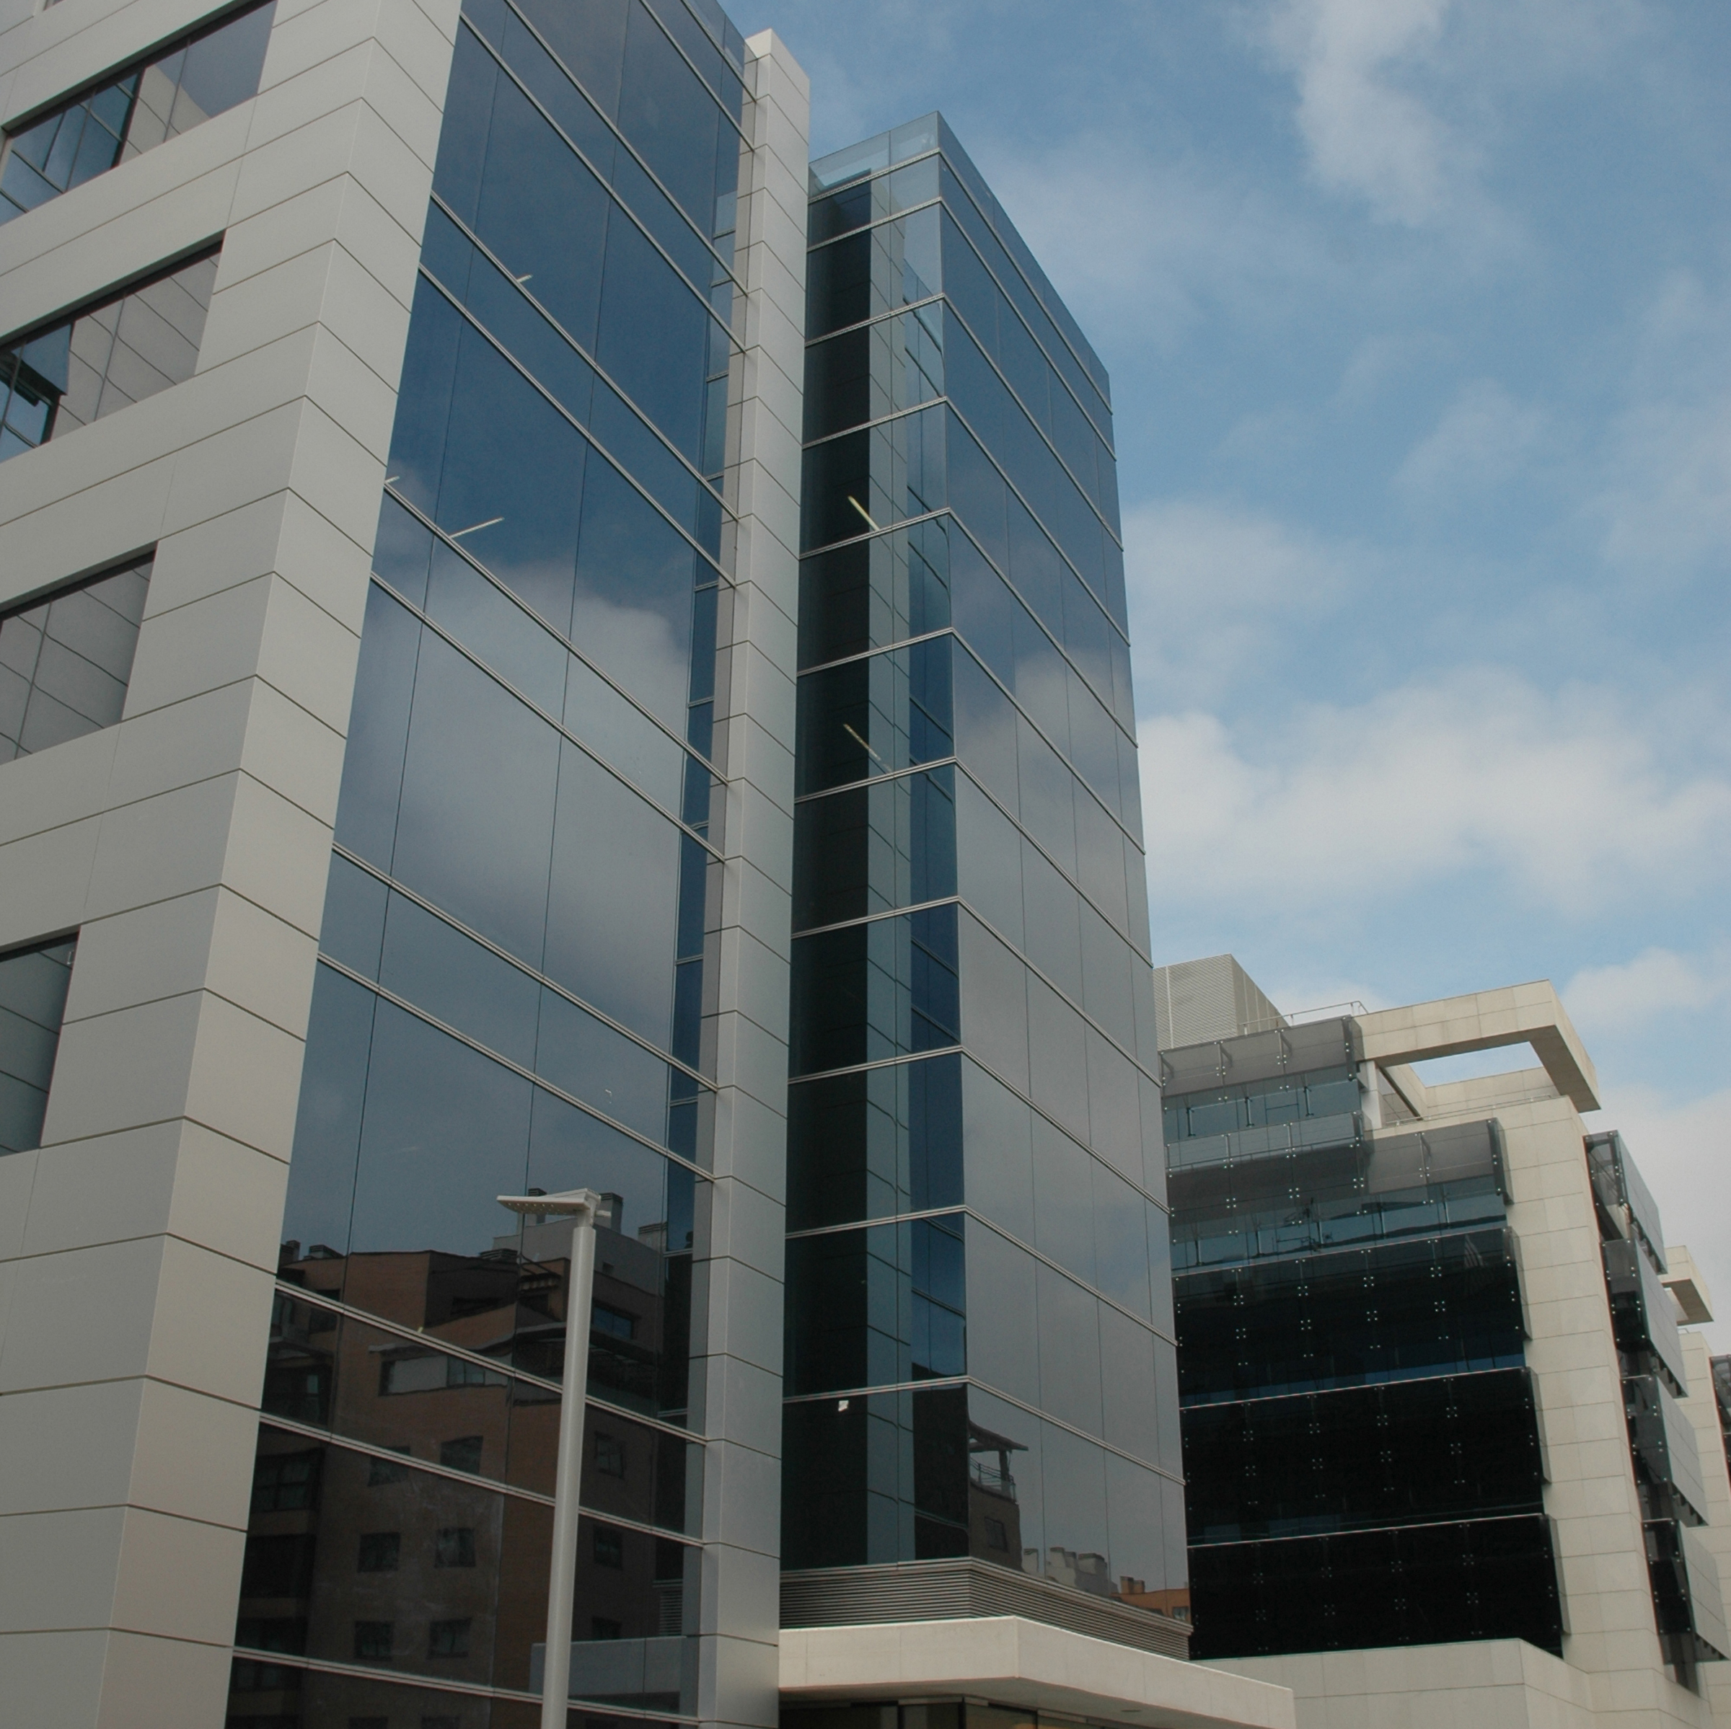


















Group FCC
Key figures in 2025
Key figures
Diversified business model
Position of leadership in all areas
International presence
Integrated offering
Value creation
Corporate Governance Structure
Management team
More than
125 years
of experience
More than 72 000
employees
International leader in environmental services, in the end-to-end water management, in infrastructure construction, and in the development of concession-based projects.
Integrated service
offering
High
revenue stability
operations in more than 25 countries,
51% of revenues comes from international markets
11.4M$
revenue
1 664 M$ EBITDA

Slide 5
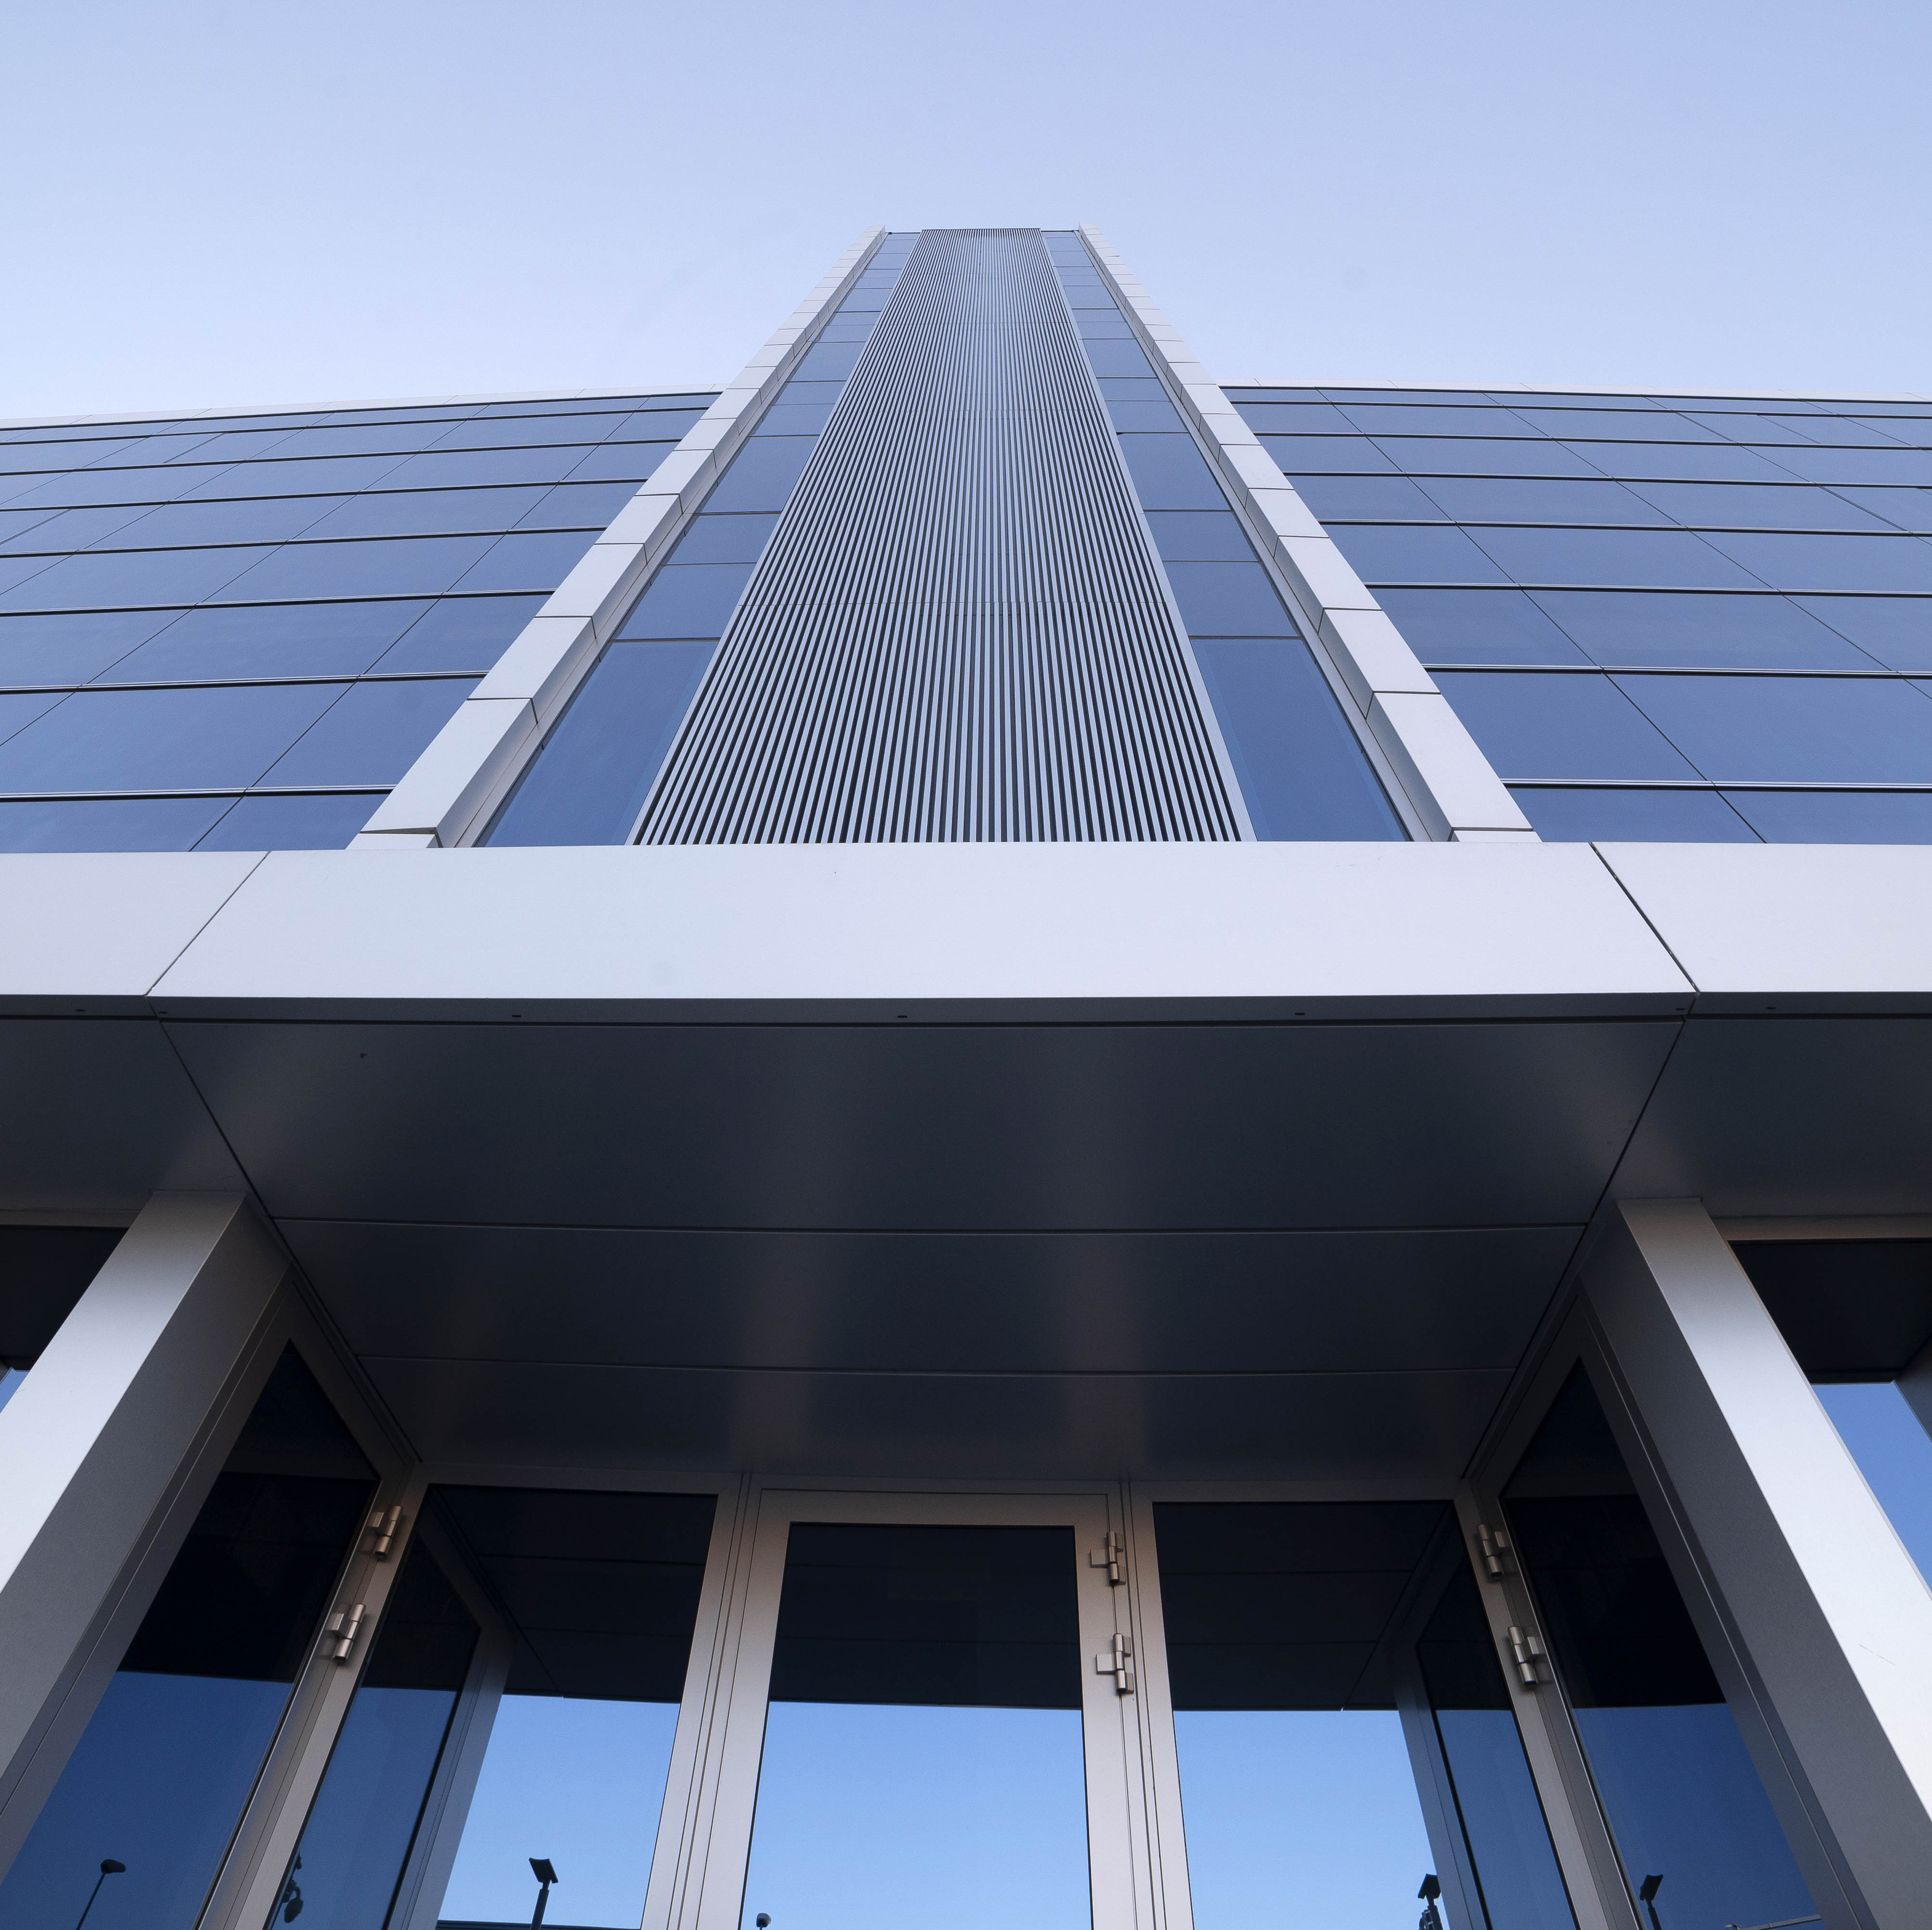

Group FCC
Key figures in 2025
Key figures
Diversified business model
Position of leadership in all areas
International presence
Integrated offering
Value creation
Corporate Governance Structure
Management team
Revenues*
11 381
10 643
9 641
+72 000
people
2023
2024
2025
EBITDA*
1 682
1 664
1 507
Backlog (31 dec.2025)
60 550M $
2023
2024
2025
* Figures in millions of USD.

Slide 6



Group FCC
Diversified business model in 2025
Key figures
Diversified business model
Position of leadership in all areas
International presence
Integrated offering
Value creation
Corporate Governance Structure
Management team
$
$
$
$
Revenues per business
EBITDA per business area
Total: $11 381 M
Total: $1 664 M
Environment
5 561 M$ / 49%
Concessions
131 M$ / 1%
Environment
926 M$ / 56%
Concessions
$70 M / 4%
Corporate
(39) M$ / 0%
Corporate
39 M$ / 0%
Construction
3 627 M$ / 32%
Water
2 100 M$ / 19%
Water
526 M$ / 32%
Construction
100 M$ / 6%

Slide 7






Group FCC
Diversified business model in 2025
Key figures
Diversified business model
Position of leadership in all areas
International presence
Integrated offering
Value creation
Corporate Governance Structure
Management team
Environment
Aqualia
Waste collection
Street cleaning
Urban waste treatment and recycling
Green space maintenance
Sewer network maintenance
Comprehensive cleaning and maintenance of buildings and
facilities
Industrial waste treatment and recycling
Contaminated land remediation
Municipal concessions the management of the public
service of the end-to-end water cycle
Infrastructure concessions under BOT contracts
Operation and Maintenance (O&M) services
Technology and Networks (EPC)
Construction
Concessions
Civil engineering
Railroad works
Industrial construction
Concessions
Infrastructure maintenance
Prefabricated construction components
Corporate image
Road infrastructure
Urban transport
Social infrastructure
Other infrastructure

Slide 8

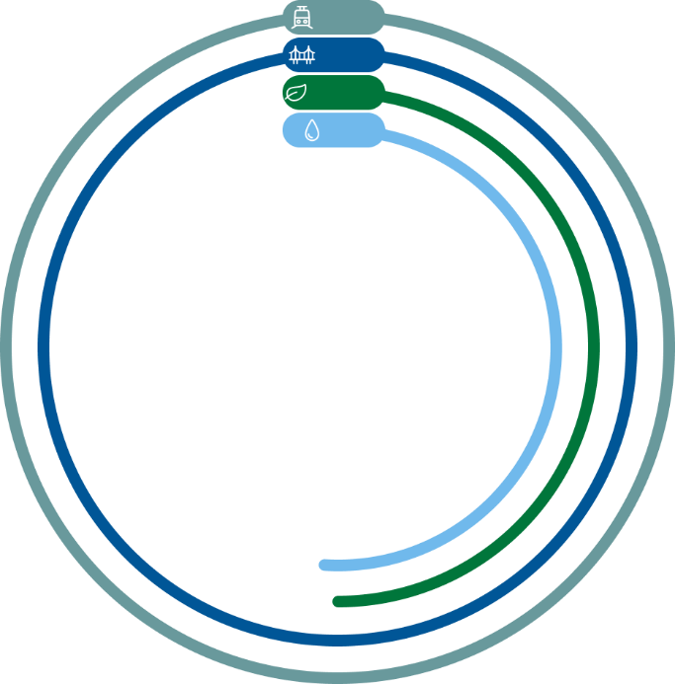


Group FCC
Diversified business model in 2025
Key figures
Diversified business model
Position of leadership in all areas
International presence
Integrated offering
Value creation
Corporate Governance Structure
Management team
Environment
Aqualia
FCC Medio Ambiente (Spain) 100%
FCC Ámbito 100%
FCC Environment France 100%
FCC Meio Ambiente Portugal 100%
FCC Environmental UK 100%
FCC Environmental Services CEE 100%
FCC Environmental Services USA 100%
Aqualia Intech 100%
Aqualia Colombia 100%
Aqualia Czech Republic 100%
Aqualia France 100%
Aqualia Georgia 100%
Aqualia Mexico 100%
Aqualia Portugal 100%
Aqualia USA 100%
100%
100%
50.01%
51%
Construction
Concessions
FCC Construction 100%
FCC Industrial 100%
Matinsa 100%
Prefabricados Delta 100%
Megaplás 100%
FCC Concessions 100%

Slide 9

Group FCC
Position of leadership in all areas
Key figures
Diversified business model
Position of leadership in all areas
International presence
Integrated offering
Value creation
Corporate Governance Structure
Management team
Europe
North America
Spain
Czech Republic
Serbia
Portugal
Poland
Slovakia
USA
UK
Austria
Hungary
Canada
Italy
Netherlands
Norway
Mexico
France
Germany
Belgium
Romania
Central America
Asia
Panama
Saudi Arabia
Georgia
Algeria
Catar
Egypt
United Arab Emirates
South America
Japan
Oman
Peru
Colombia
Chile
Oceania
Australia
Construction
Environment
Water
Concessions
#1 in Spain ⁽¹⁾.
#5 in EU ⁽¹⁾.
#1 in end-to-end waste management services in Central and Eastern Europe ⁽¹⁾.
Among the top 15 in the USA. ⁽¹⁾.
Among the top 7 in the world ⁽¹⁾.
Top 5 in the UK.
#1 in Spain ⁽²⁾.
#4 in Europe ⁽²⁾.
#9 in the world ⁽²⁾.
#3 in Spain ⁽¹⁾.
Among the 15 largest construction companies in Europe ⁽²⁾.
Among the top 10 concessionaires in Europe.
(1) By revenue volume​. (2) Source: December 2022 GWI Ranking.

Slide 10

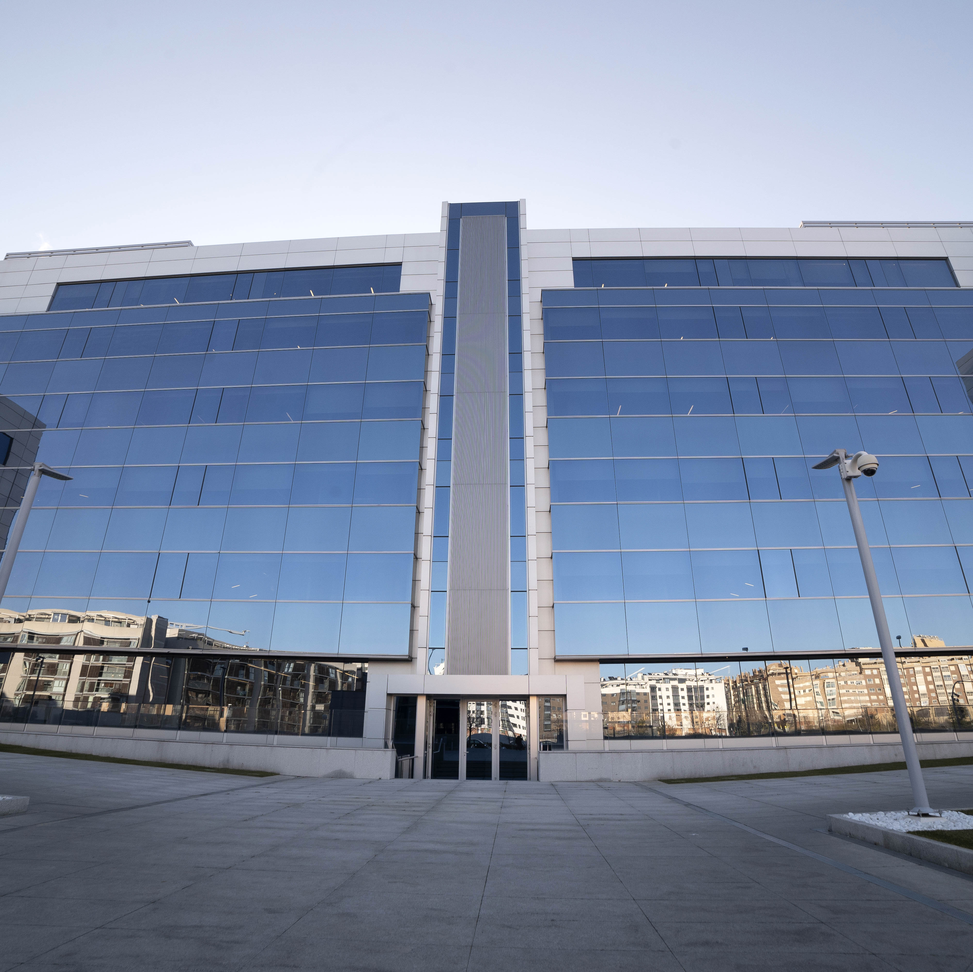
Group FCC
International Presence in 2025
Key figures
Diversified business model
Position of leadership in all areas
International presence
Integrated offering
Value creation
Corporate Governance Structure
Management team
International Revenues
Total: 5 729 M$ / 50%
America 14%
1 642 M$
United Kingdom 11%
1 200 M$
Czech Republic 5%
553 M$
50%
Asia, Africa and Australia 3%
355 M$
Rest of Europe 17%
1 889 M $
International Backlog (31 dec.2025)
35 741 M$
*59% of total.

Slide 11
Group FCC
Integrated Offering
Key figures
Diversified business model
Position of leadership in all areas
International presence
Integrated offering
Value creation
Corporate Governance Structure
Management team
Proprietary technology for waste collection and street cleaning.
Leadership in recycling systems and energy recovery from waste.
Experts in providing solutions across all phases of the end-to-end water
cycle for all uses: residential, agricultural, and industrial, and for all needs of
public and private entities and organizations.
Specialists in technically complex bridges and ports.
Innovative processes for high-speed rail, metro, and tunnels.
Specialists in turnkey projects in the industrial sector.
Environment
Water
Activity across the entire value chain
Construction
Concessions
Advanced technology and integrated offering of high value-added products across all business areas.

Slide 12
Group FCC
Value Creation
Key figures
Diversified business model
Position of leadership in all areas
International presence
Integrated offering
Value creation
Corporate Governance Structure
Management team
Our leadership allows us to capitalize on the demand for our activities.
Environment
Positive long-term outlook due to regulatory developments and environmental considerations. The EU Waste Framework Directive requires Member States to recycle at least 60% of their municipal solid waste by 2030 and 65% by 2035, and to reduce landfill to 10% by 2035.
Strong potential for international expansion, particularly in the UK, certain Central European countries, and growth of the energy recovery division in the United States.
Water
Aqualia’s business model is distinguished by ensuring an essential service for life, social well-being and industrial development, adapting to the specific characteristics of each of the 19 countries in which it operates; thanks to its solid experience and strategic leadership, the company adds value in changing environments through a global vision translated into concrete and effective local actions and solutions.
Will continue its development under a strict geographical selection criterion, prioritizing activities in regulated environments and contracts where its technical, engineering, and digitalization capabilities provide competitive advantages.
Construction
Will continue to focus on markets with a stable presence and projects with secured financing.
Selective contracting, both domestically and internationally, through rigorous risk management to ensure profitability and cash flow generation.
Concessions
To become a benchmark in the Infrastructure Concessions sector in all the countries where it is already present and to expand its presence into new markets.
Continuous pursuit of growth with a strategic focus on the international arena, primarily in the United States, Europe (Czech Republic, the UK, Portugal, and Ireland), and the Middle East as key markets.

Slide 13



Group FCC
Value Creation
Key figures
Diversified business model
Position of leadership in all areas
International presence
Integrated offering
Value creation
Corporate Governance Structure
Management team
Experience
More than 125 years of creating value for citizens.
Internationalization
Present in more than 25 countries.
Innovation and
Technological Capacity
More than 16.43M$ in R&D&I and advancements to optimize efficiency, address digital challenges, and promote sustainable practical solutions
Professionalism
More than 72 000 professionals
specialized in various areas.
Quality
Certified quality management systems
according to UNE-EN ISO 9001
in all business areas.
Environmental care
Certified environmental management systems certified according to UNE–EN ISO 14001 in all business areas
Health and Safety
Certified Occupational risk management systems according to ISO 45001 in all business areas.
Local development
More than 6.8 M$ allocated to sponsorships and contributions to non‑profit entities, foundations, and sector associations.

Slide 14

Group FCC
Corporate Governance Structure
Key figures
Diversified business model
Position of leadership in all areas
International presence
Integrated offering
Value creation
Corporate Governance Structure
Management team
Shareholding Structure
Composition of the Board
CEC
69.6%
11 members:
E. Koplowitz
3.2%
8 Dominical Directors.
2 Independent Members.
1 Executive Director.
Audit and Remuneration Board Commissions:
Chaired by independent members.
Majority of independent members.
Finver Inversiones
11.8%
Free Float
15.3%

Slide 15

Group FCC
Management Team
Key figures
Diversified business model
Position of leadership in all areas
International presence
Integrated offering
Value creation
Corporate Governance Structure
Management team
Esther Alcocer Koplowitz
Chairman FCC
Pablo Colio Abril
Chief Executive Officer
Business Areas
Íñigo Sanz Pérez
Environment
Santiago Lafuente Pérez-Lucas
Water
Pablo Colio Abril
Construction
Ramón Gómez Andrío
Concessions

Slide 16
2
Aqualia
Strategic Pillars
Value chain
Key figures
International presence
Business model
Values
Key objectives and challenges
Lines of action
References
Sustainability as a strategic driver
R&D&I strategy
Digitalization
Aqualia

Slide 17
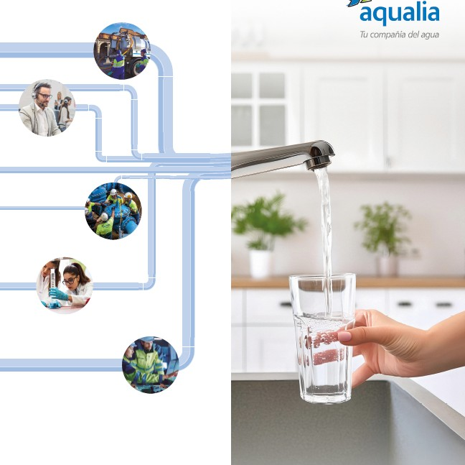
Aqualia
More than
what you see
Strategic Pillars
Value chain
Key figures
International presence
Business model
Values
Key objectives and challenges
Lines of action
References
Sustainability as a strategic driver
R&D&I strategy
Digitalization
Aqualia is a leading international operator in the end-to-end water cycle, specializing in water supply, sanitation, and wastewater treatment.
With more than 14 200 professionals, the company delivers efficient and innovative solutions that protect water resources, safeguard the environment, and place people at the center of its operations.
Aqualia’s business model combines sustainable development, social commitment, and balanced profitability, adapting its services to the specific needs of each region to create value and enhance wellbeing in the communities it serves.
Committed to the efficient management of the end-to-end water cycle.
A commitment to you.

Slide 18


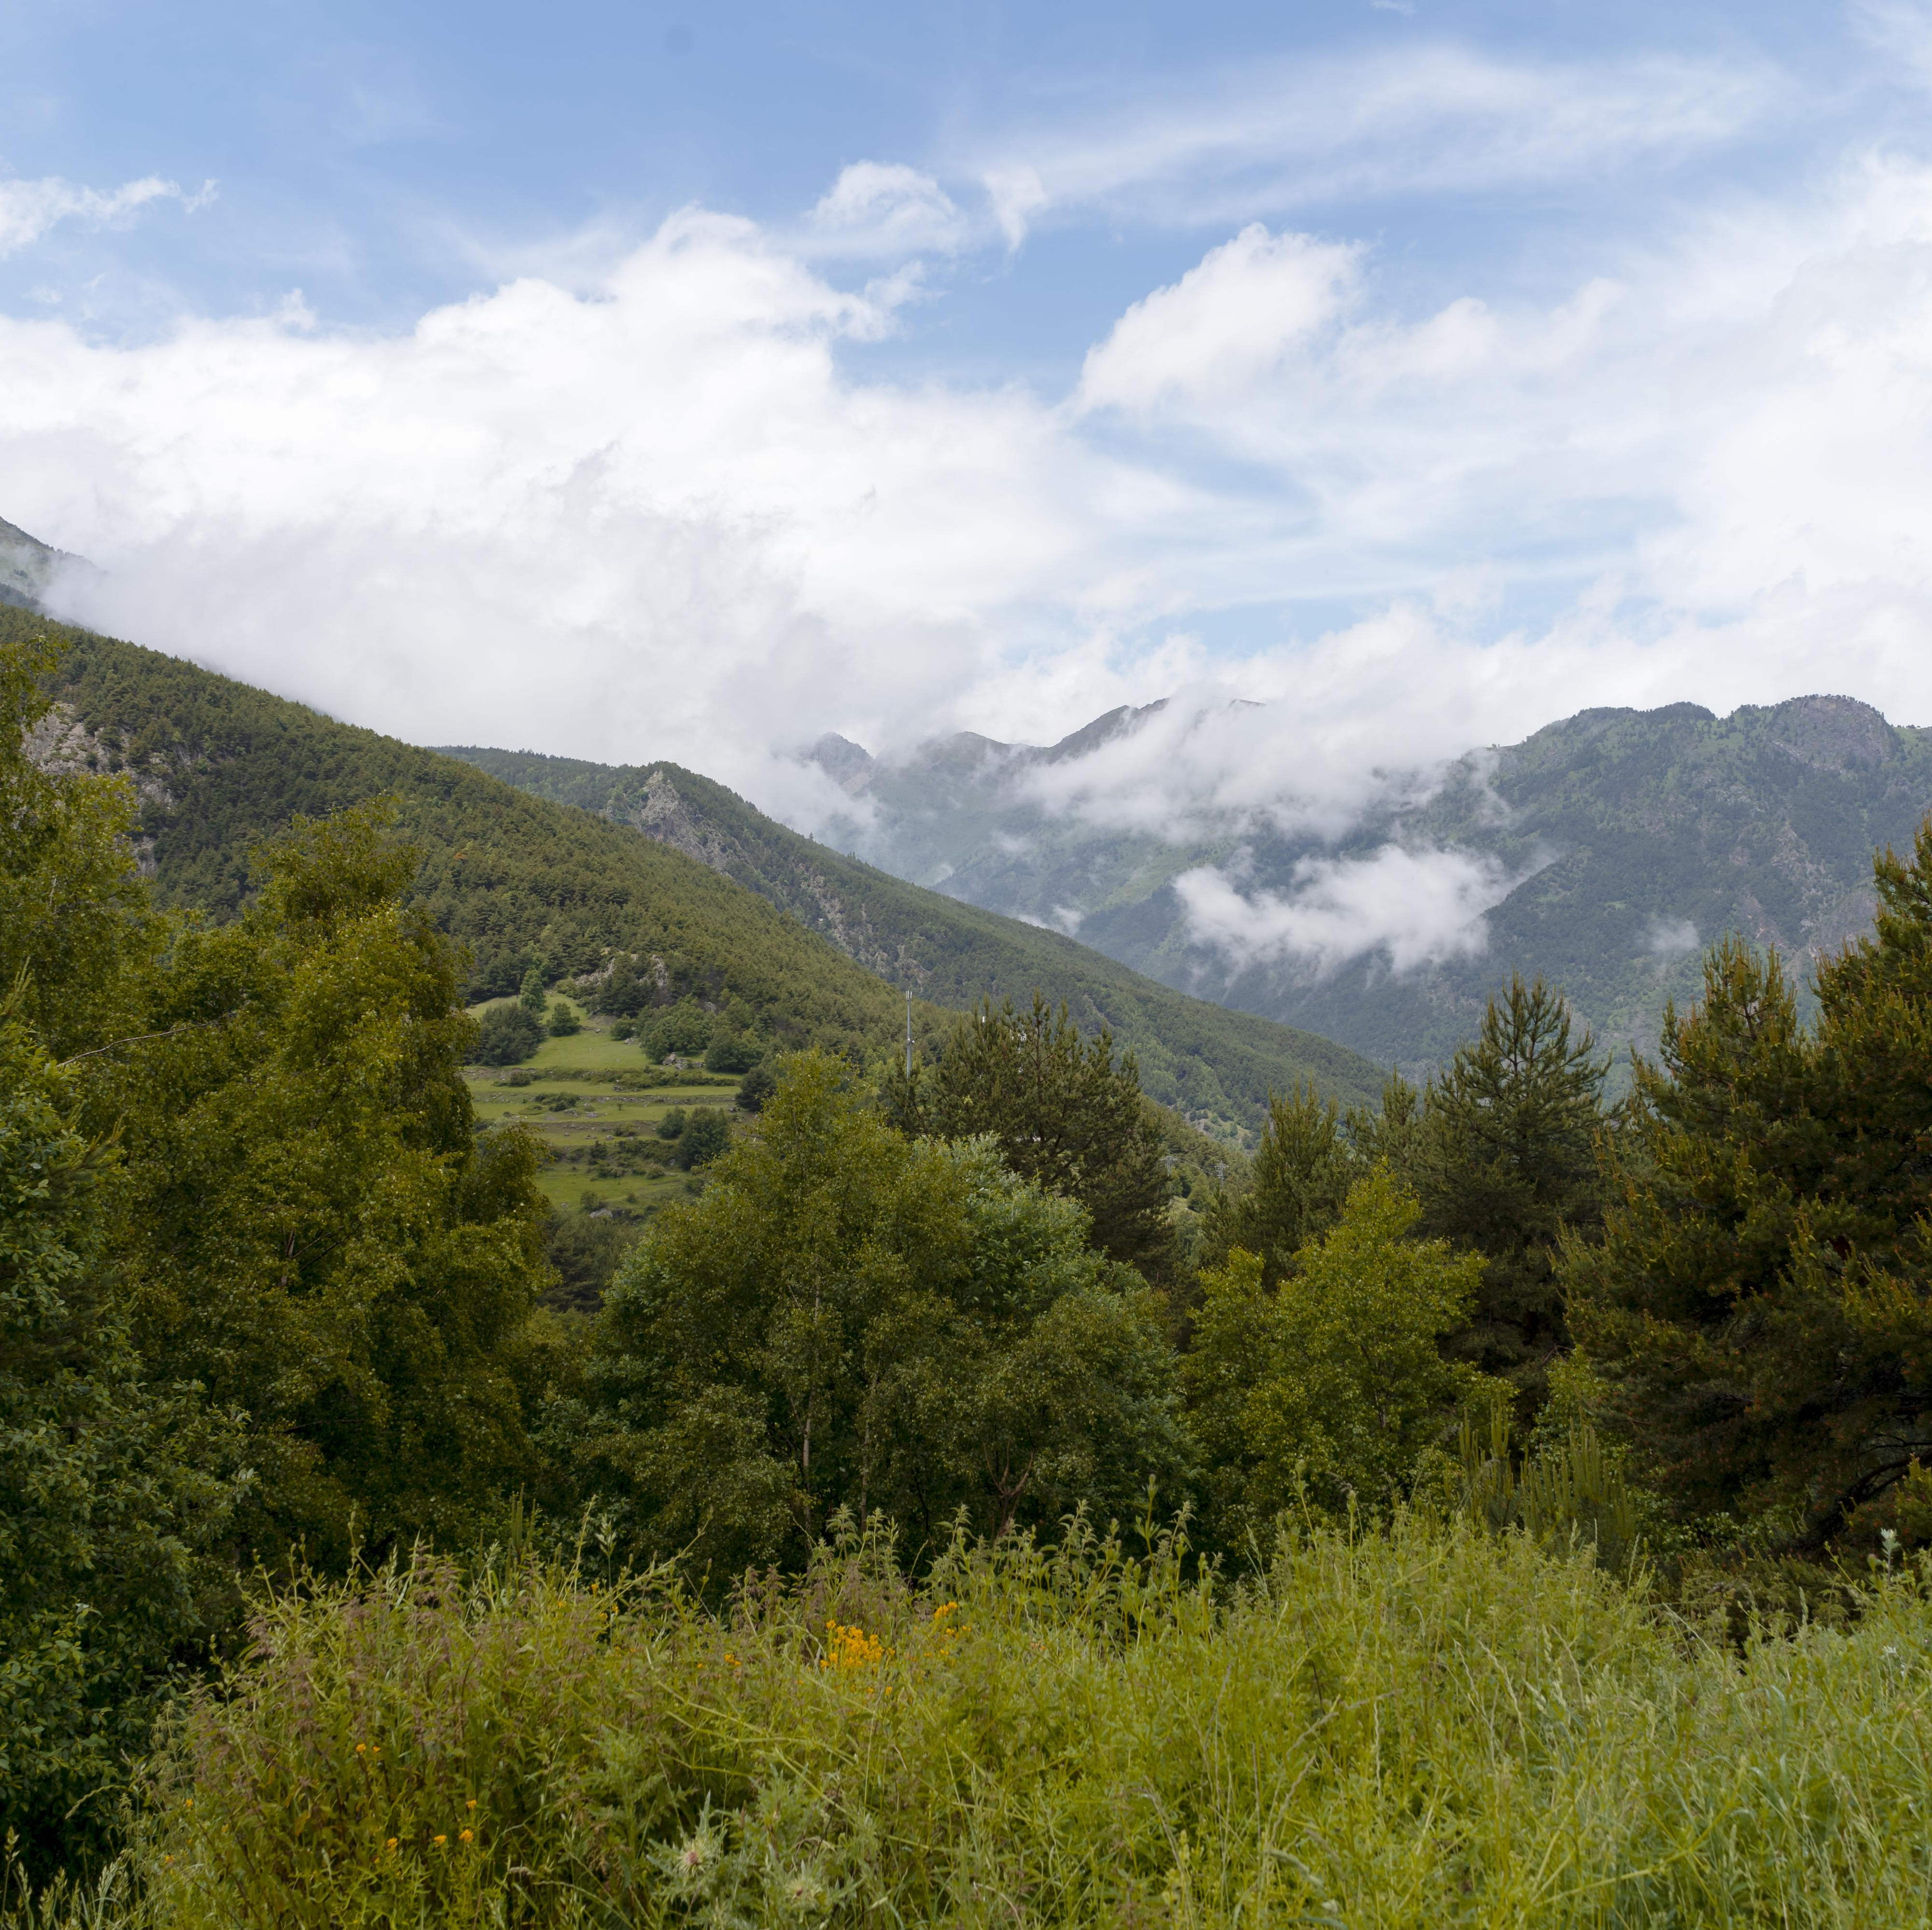




Aqualia
Strategic Pillars
Strategic Pillars
Value chain
Key figures
International presence
Business model
Values
Key objectives and challenges
Lines of action
References
Sustainability as a strategic driver
R&D&I strategy
Digitalization
Sustainability
Our activities contribute to several of the goals of the 2030 Agenda, particularly the responsible use of water as a scarce resource, as well as efforts to combat pollution, climate change, and their environmental and social impacts. To achieve this, driving innovation in sustainability and playing a significant role in the circular economy are top priorities.
Digitalization and Technology
The company’s digital transformation and the application of technological solutions across its processes are shaping our present and future. The development of these areas enables us to optimize the management of the end-to-end water cycle and, as a result, reduce or prevent losses in water distribution networks, while also improving all processes related to the company’s internal organization and customer service.
Internationalization
Our actions are closely linked to sustainable growth and international expansion to meet global needs for clean water and sanitation, particularly in Europe, the Americas, Africa, and Asia.

Slide 19

















Aqualia
Value chain
Strategic Pillars
Value chain
Key figures
International presence
Business model
Values
Key objectives and challenges
Lines of action
References
Sustainability as a strategic driver
R&D&I strategy
Digitalization
Upstream
Downstream
Public Administrations and Regulators:
National, Regional, and Local Governments.
Oversight Bodies.
Data Protection Authorities.
Service Owner:
National, regional, and local governments, and industrial companies.
Financial institutions, shareholders, investors, and capital providers.
Business partners.
Suppliers and subcontractors.
The environment, as a stakeholder from which the water resource is sourced.
Service Owners as Customers:
National, Regional, and Local Governments
Industrial companies.
Users and Other Customers:
Citizens (end users)
Agricultural customers (irrigation communities)
Potential customers
Society:
Citizens.
Neighborhood associations/ Consumer organizations
Local communities and Indigenous populations
Foundations and associations
Environment.
Shareholders and investors.
Analysts:
Auditors and certifiers
Financial and non‑financial rating agencies
Academia:
Universities, research centers, researchers, and scientists
1
3
4
2
End-to-end Water Cycle
Water Supply
Sanitation
1.
COLLECTION
2.
TREATMENT
3.
DISTRIBUTION
4.
SEWER
5.
WASTEWATER TREATMENT
6.
REUSE
5
6
Laboratories
Engineering
Construction
Customer Management
Waters in nature
Drinking water
Wastewater

Slide 20











Aqualia
Key figures in 2025
Strategic Pillars
Value chain
Key figures
International presence
Business model
Values
Key objectives and challenges
Lines of action
References
Sustainability as a strategic driver
R&D&I strategy
Digitalization
19
countries present
3 285
drinking water reservoirs
2 346
municipalities served
44 985 072
population served
20
sports centers
937 969 acre-feet
drinking water reservoirs
57 000 miles
networks managed
273
Drinking Water Treatment Plants (DWTP)
934
Wastewater
Treatment
Plants (WWTP)​
37
desalination
plants (SWDP
/ BWDP)​
24
laboratories
that ensure
water quality
14 200
employees
REVENUES
EBITDA
BACKLOG
(M$) Turnover
2 100
(M$) EBITDA
527
(M$) 31 dec. 2025
27 291

Slide 21
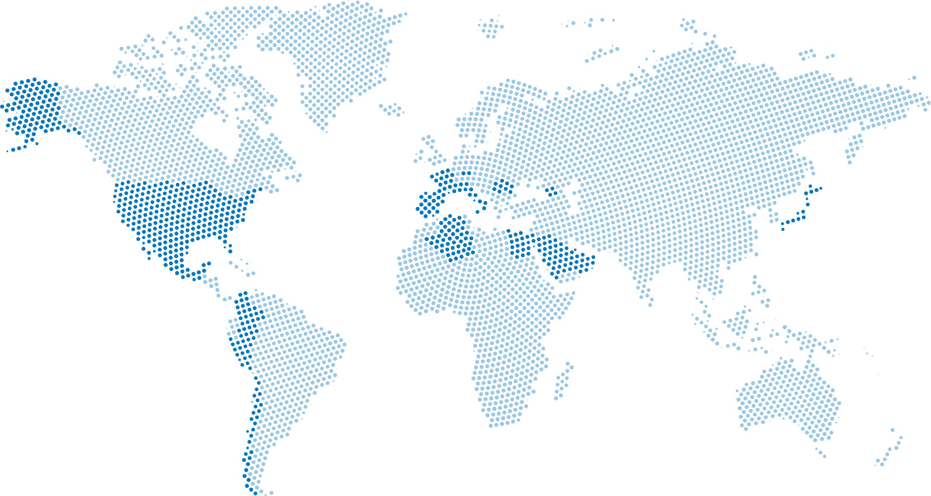
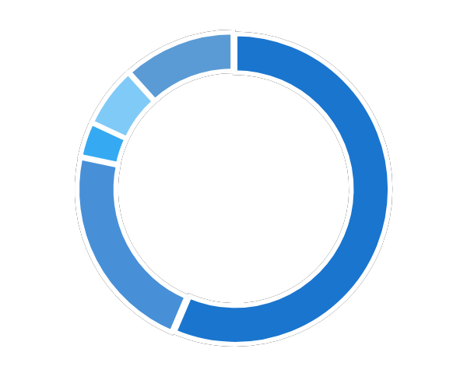
Aqualia
International Presence
Strategic Pillars
Value chain
Key figures
International presence
Business model
Values
Key objectives and challenges
Lines of action
References
Sustainability as a strategic driver
R&D&I strategy
Digitalization
Aqualia operates in 19 countries across Europe, the Americas, North Africa, and Asia.
Czech
Republic
Romania
2025 Revenue Turnover:
Spain
1 222 M$
58.1%
International
880 M$
41.9%
Georgia
France
United States
Americas
252.6 M$ / 12%
Spain
Portugal
Japan
Asia
115 M$ / 5.5%
Mexico
Italy
Catar
Colombia
Egypt
North of Africa 62.3 M$ / 3%
Peru
Algeria
Oman
United Arab Emirates
Spain
1.222 M$ / 58.1%
Chile
Rest of Europe 451 M$/ 21.4%
Saudi Arabia

Slide 22







Aqualia
Aqualia’s Business Models
Strategic Pillars
Value chain
Key figures
International presence
Business model
Values
Key objectives and challenges
Lines of action
References
Sustainability as a strategic driver
R&D&I strategy
Digitalization
Management of the water cycle (MWC) concessions
Management of public utility services, including water collection, treatment, drinking water production, distribution, sewer, and wastewater treatment, as well as water quality analysis.
Operation and maintenance (O&M)
Operation, maintenance, and (O&M) contracts ensure the continuous availability of high‑quality water, which requires the dedication, technology, professionalism, and experience necessary to achieve the highest level of excellence across all processes of the end-to-end water cycle.
Infrastructure concessions (BOT)
Infrastructure concessions in which Aqualia designs, builds, finances, and operates infrastructure over the long-term, including treatment plants (drinking water treatment, wastewater treatment, and desalination) or water reuse facilities, under BOT‑type contracts and take‑or‑pay mechanisms, whereby recovery of the investment associated with the infrastructure is guaranteed without assuming demand risk.
Technology and networks (EPC)
Design and construction projects for water infrastructure, mainly for our own concessions and flagship projects. Our experience working with leading construction companies enables us to form partnerships that reduce and mitigate construction risks.

Slide 23

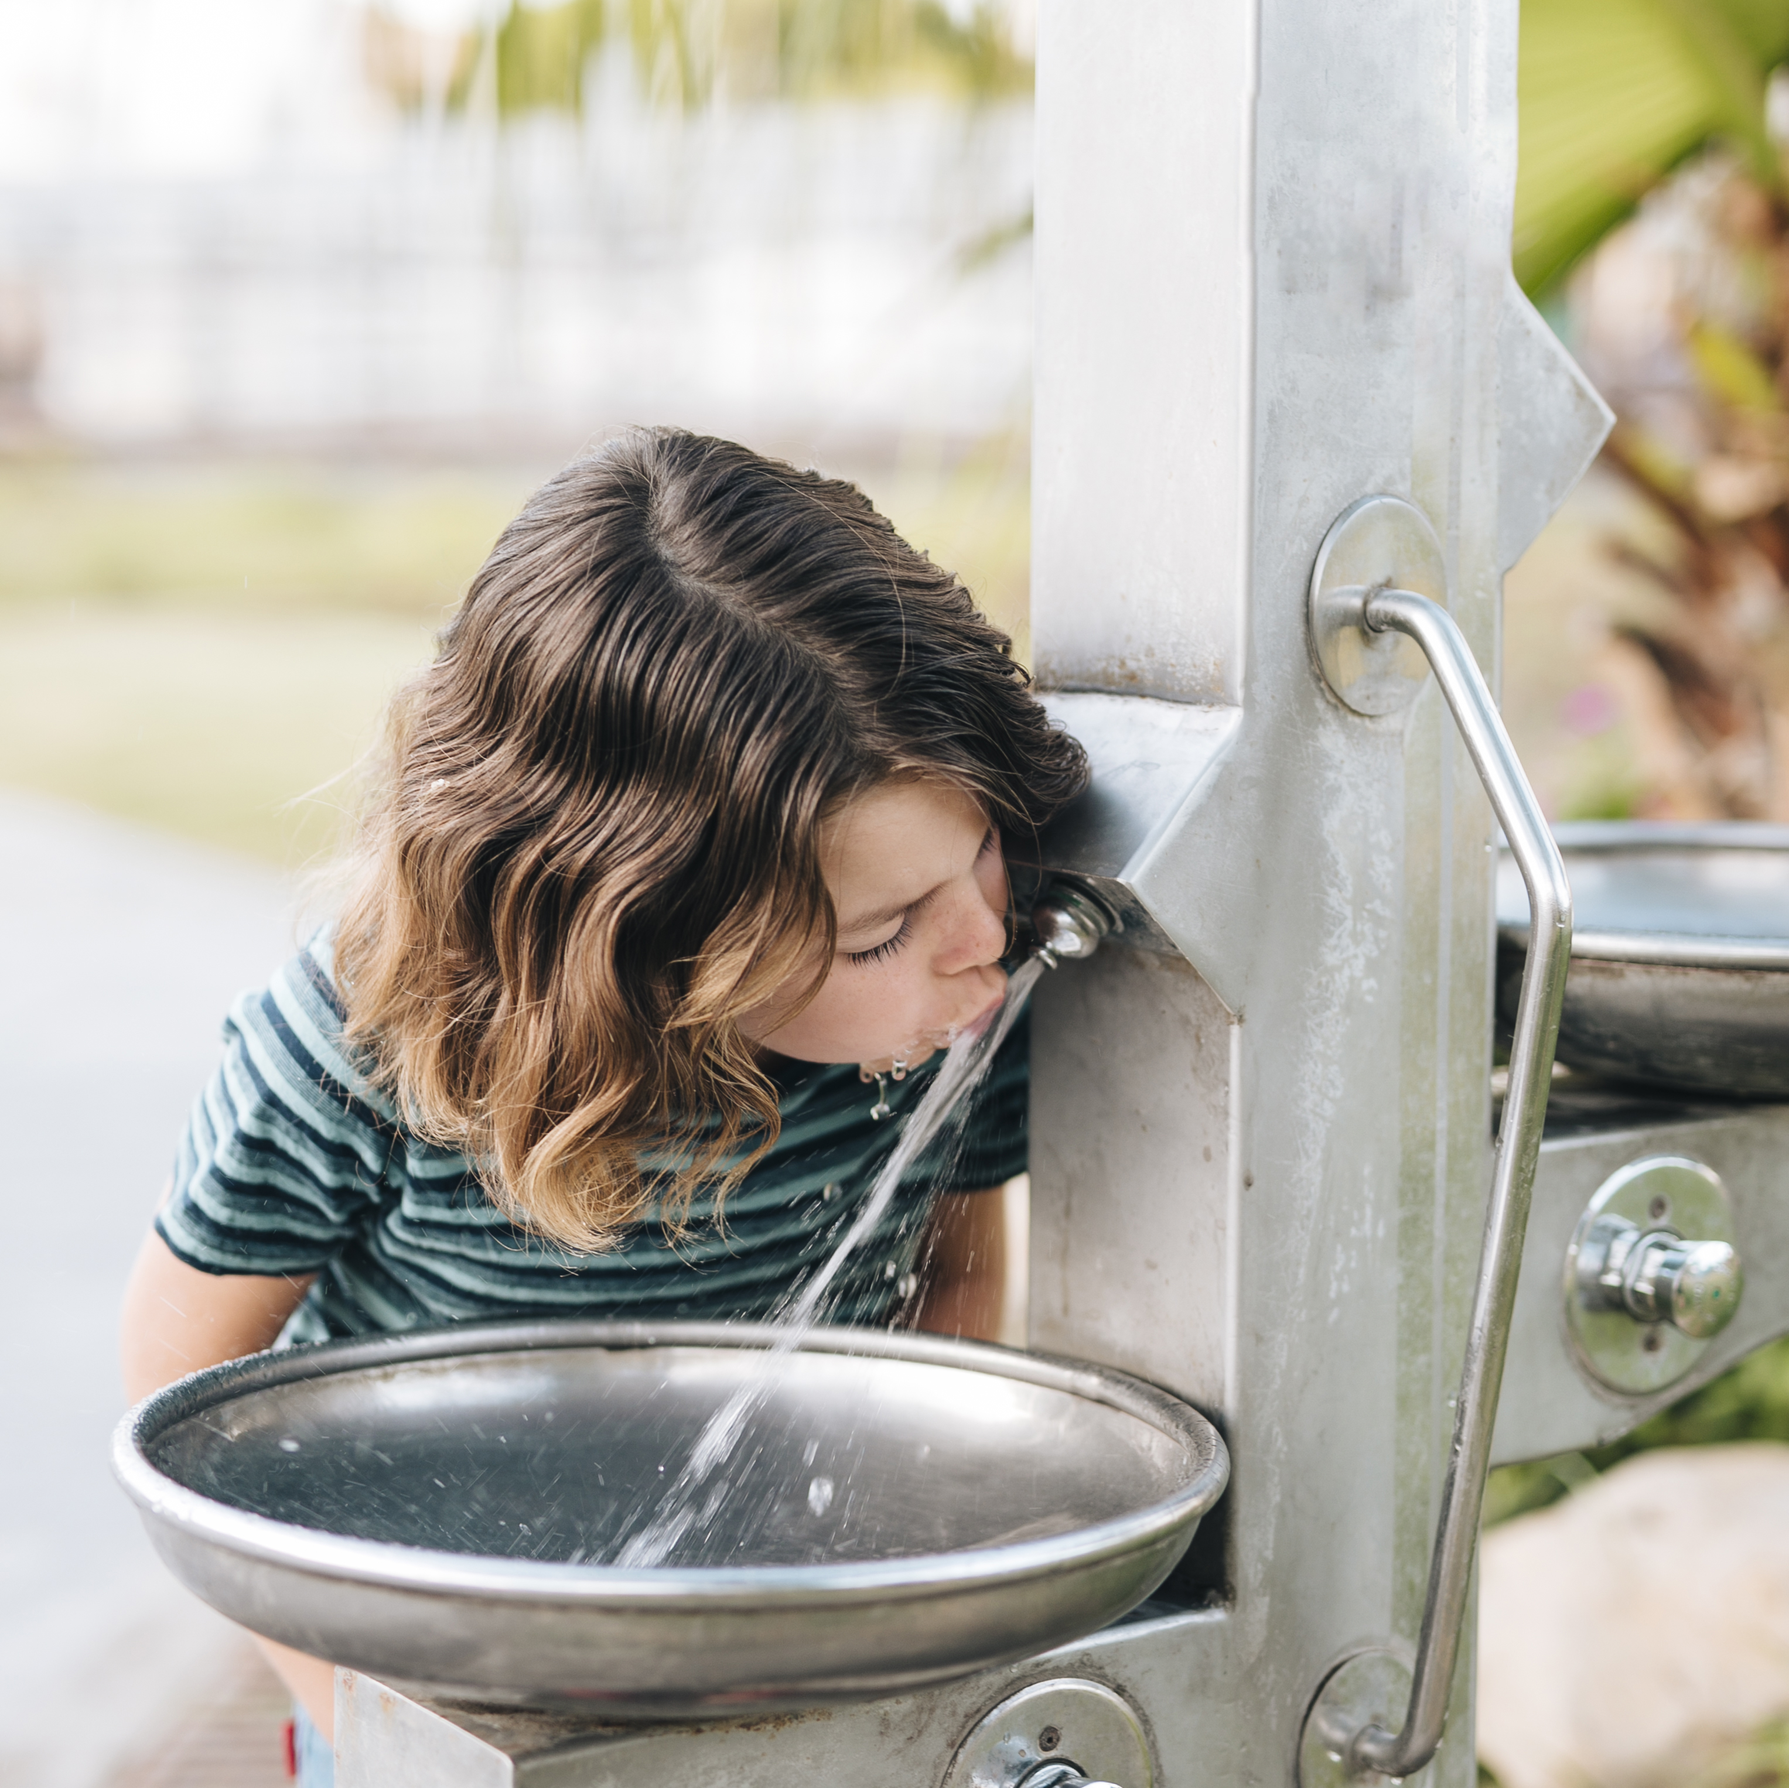








Aqualia
Our Values
Strategic Pillars
Value chain
Key figures
International presence
Business model
Values
Key objectives and challenges
Lines of action
References
Sustainability as a strategic driver
R&D&I strategy
Digitalization
Aqualia's purpose is to ensure the well-being and progress of the people and communities we serve by providing a public service: sustainable water management. Proudly and firmly guaranteeing the universal and local right to water.
Our values are based on caring for people through efficient water management:
Customer-oriented.
Transparent.
Efficient and specialized.
Ethical and with integrity.
Committed to the environment.
Innovative.
Socially involved.
Based on digitalization.

Slide 24








Aqualia
Key objectives and challenges
Strategic Pillars
Value chain
Key figures
International presence
Business model
Values
Key objectives and challenges
Lines of action
References
Sustainability as a strategic driver
R&D&I strategy
Digitalization
At Aqualia we are aware that, as a society, we face multiple and, to this end, the company is adapting by defining goals based on triple sustainability:
Environmental
Adaptation to climate emergency and water stress.
Protection of biodiversity.
Access to renewable energies.
Social
Access to water for vulnerable people and families.
Social awareness of water care and quality.
Economic
Optimizing the management of the water cycle, its quality and availability, to enable the development and quality of life of millions of people.

Slide 25




Aqualia
Lines of Action
Strategic Pillars
Value chain
Key figures
International presence
Business model
Values
Key objectives and challenges
Lines of action
References
Sustainability as a strategic driver
R&D&I strategy
Digitalization
Climate Change
Promote initiatives aimed at minimizing and adapting to climate change.
Technology and innovation
Develop a technology that allows efficient management and use so that citizens can enjoy access to water guaranteed by Aqualia.
Culture and ethical values
Transfer Aqualia's culture, ethical values and compliance to the entire company and the supply chain through a 360º implementation.
Our people
Continue contributing to the health and well-being of our people, as well as to equality and diversity and to dignified and healthy employment.
Communities
To guarantee people's access to water and strengthen Aqualia's links with all the local communities in which we operate.
Strategic alliances
To have the support of strategic alliances that help us to achieve these objectives and to communicate the value we bring.

Slide 26
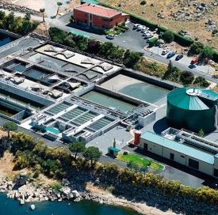
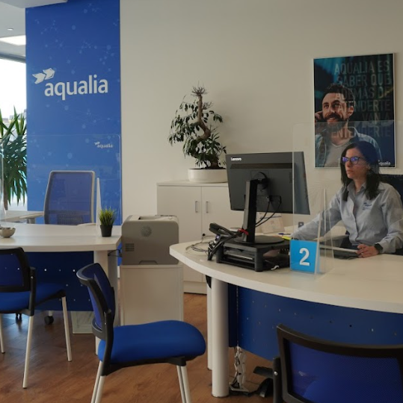
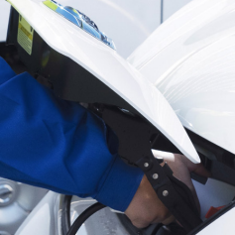
Aqualia
Aqualia in Spain
Strategic Pillars
Value chain
Key figures
International presence
Business model
Values
Key objectives and challenges
Lines of action
References
Sustainability as a strategic driver
R&D&I strategy
Digitalization
We lead the end-to-end water management thanks to highly specialized human capital, advanced technological development, and R&D&I projects that enable us to implement smart solutions to optimize every stage of the water cycle.
We provide services in 1 171 municipalities.

Slide 27
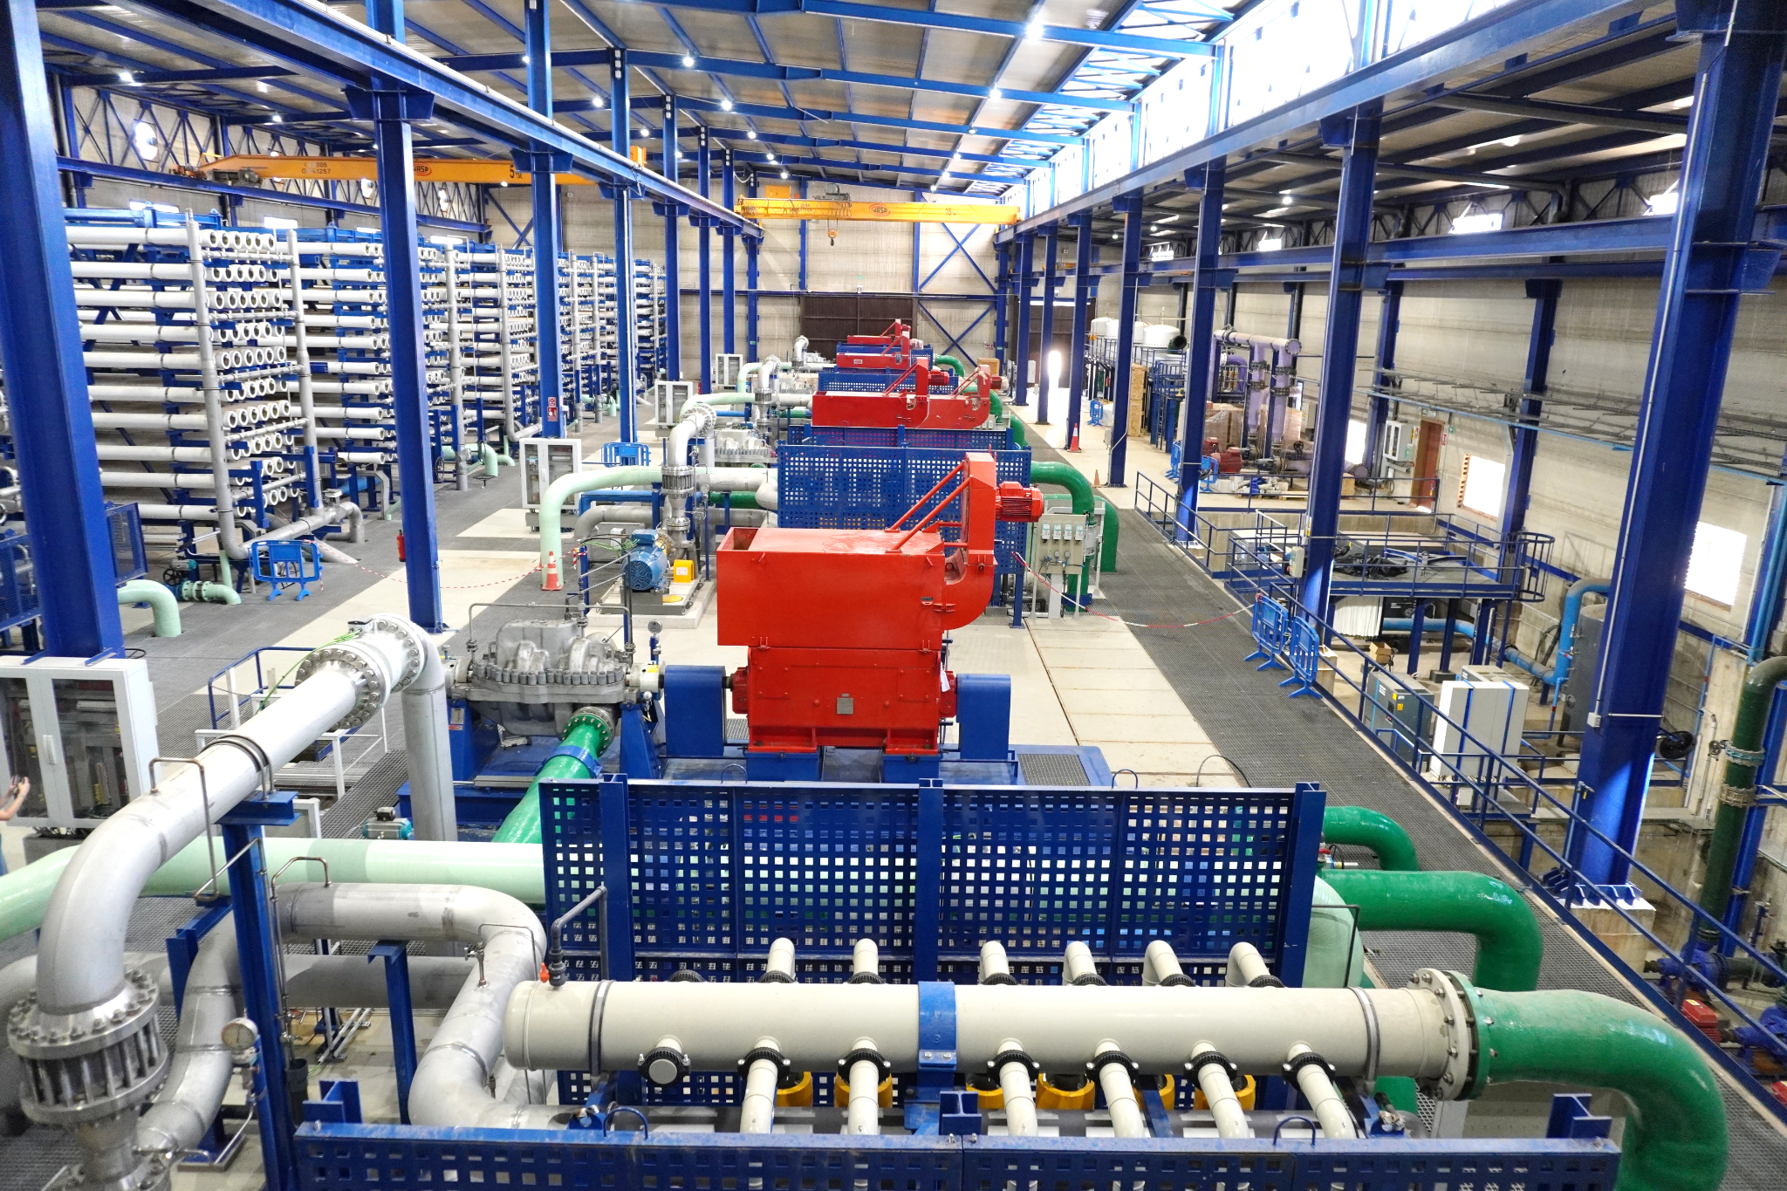
Aqualia
References in Spain
Strategic Pillars
Value chain
Key figures
International presence
Business model
Values
Key objectives and challenges
Lines of action
References
Sustainability as a strategic driver
R&D&I strategy
Digitalization
Mar de Alborán Desalination Plant in Cabo de Gata, Almería
The rehabilitation of the Rambla Morales desalination plant, abandoned since 2011 by the local Irrigation Community of the same name, has involved a total investment of $116.3 million. This project has become a technological benchmark and a relief for the overexploitation of the aquifers in the Campo de Níjar region.
Since 2025, the desalination plant has been operational, using one rack that supplies 4 054 acre-feet of water to the area’s agricultural fields. In 2026, the remaining racks are expected to come into operation, reaching a total capacity of 16 214 acre-feet.

Slide 28
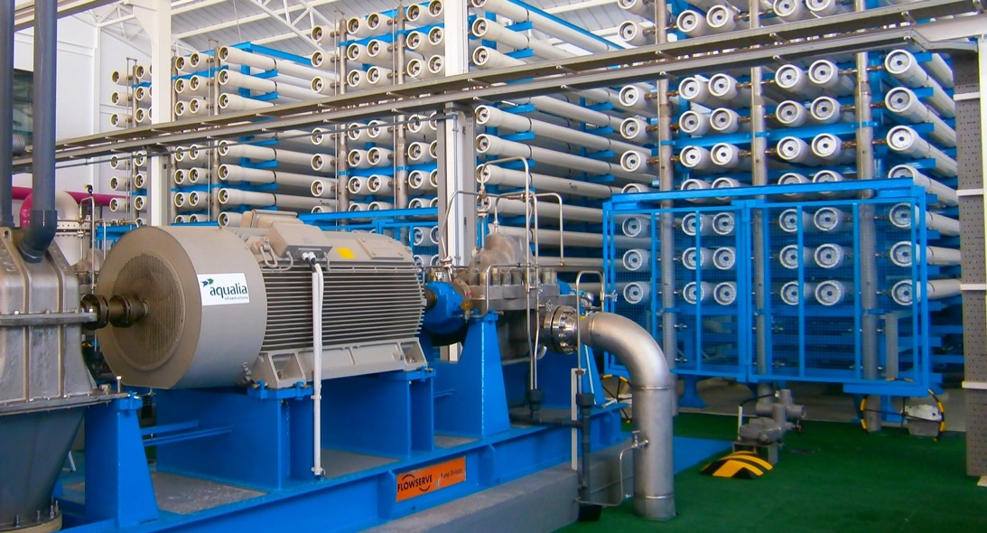
Aqualia
References in Spain
Strategic Pillars
Value chain
Key figures
International presence
Business model
Values
Key objectives and challenges
Lines of action
References
Sustainability as a strategic driver
R&D&I strategy
Digitalization
Ibiza Desalination Plants, Balearic Islands
Client: Balearic Water Agency (ABAQUA).
Population: 150 000 inhabitants.
Management of the three desalination plants on the island of Ibiza (Ibiza, Santa Eulalia, and San Antonio), with a total production capacity of 36.5 acre-feet/day, supplying 8 107 acre-feet of water per year.
The project also includes the high‑level interconnection system across the island of Ibiza, which links the three desalination plants through an extensive network of pipelines, storage tanks, and pumping stations.

Slide 29
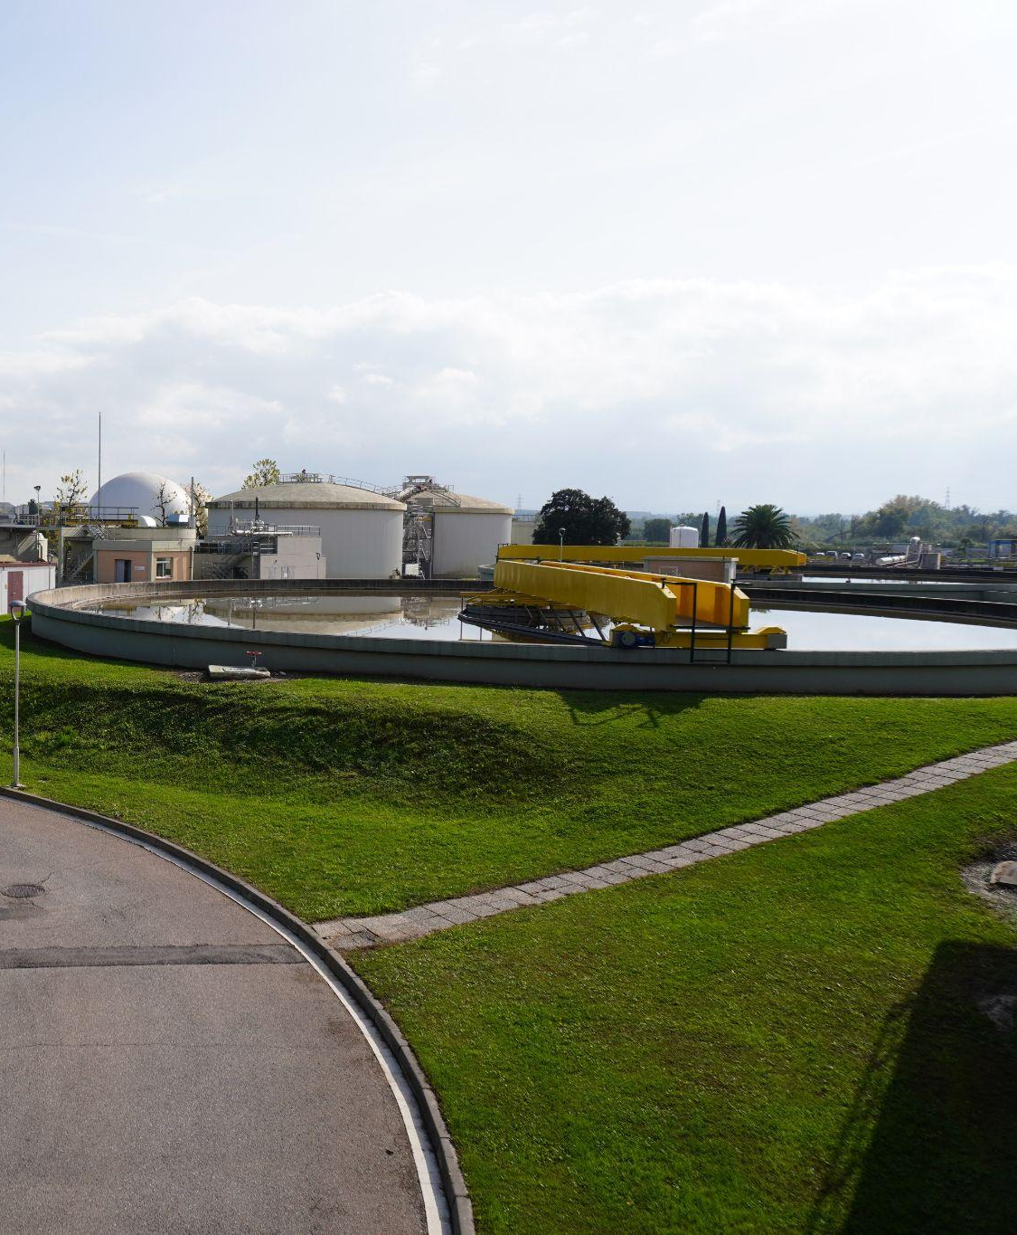
Aqualia
References in Spain
Strategic Pillars
Value chain
Key figures
International presence
Business model
Values
Key objectives and challenges
Lines of action
References
Sustainability as a strategic driver
R&D&I strategy
Digitalization
Lleida Wastewater Treatment Plant
Management since 1996.
Population: 146 266 inhabitants.
It is the most important wastewater treatment plant in Catalonia and the first facility in Spain to calculate and verify, with AENOR, a zero-carbon footprint within the End-to-end Water Cycle of Lleida.
The plant has a strong track record of high efficiency in contaminant removal, reduction of energy costs, and the development of innovative initiatives aimed at a circular, sustainable, and decarbonized economy.

Slide 30
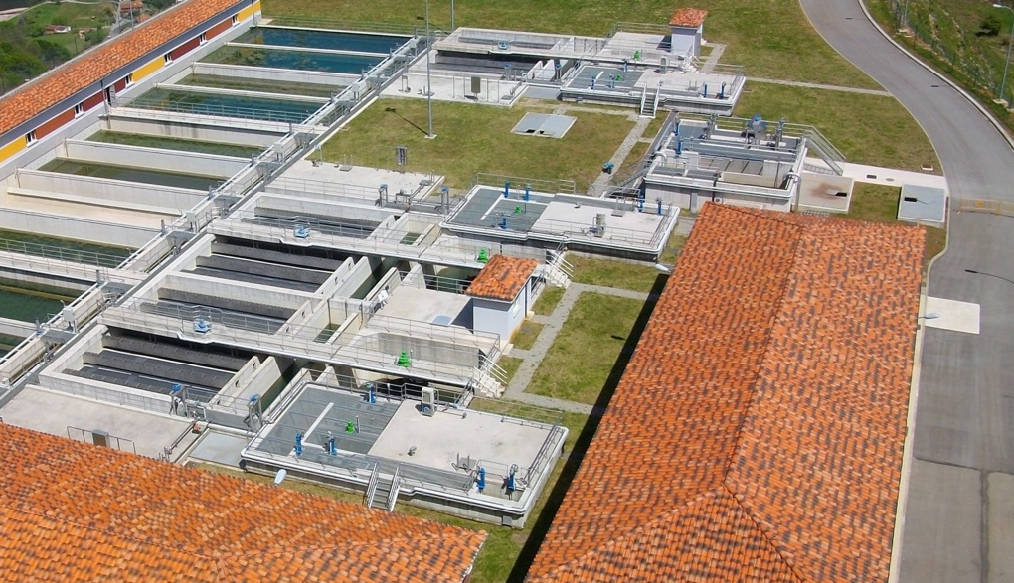
Aqualia
References in Spain
Strategic Pillars
Value chain
Key figures
International presence
Business model
Values
Key objectives and challenges
Lines of action
References
Sustainability as a strategic driver
R&D&I strategy
Digitalization
End-to-end Water Management in Oviedo
Management since 1996.
Client: Oviedo City Council.
Population: 223 968 inhabitants.
The only municipality in Asturias with ozone-based drinking water treatment, producing 1 500 liters per second.

Slide 31
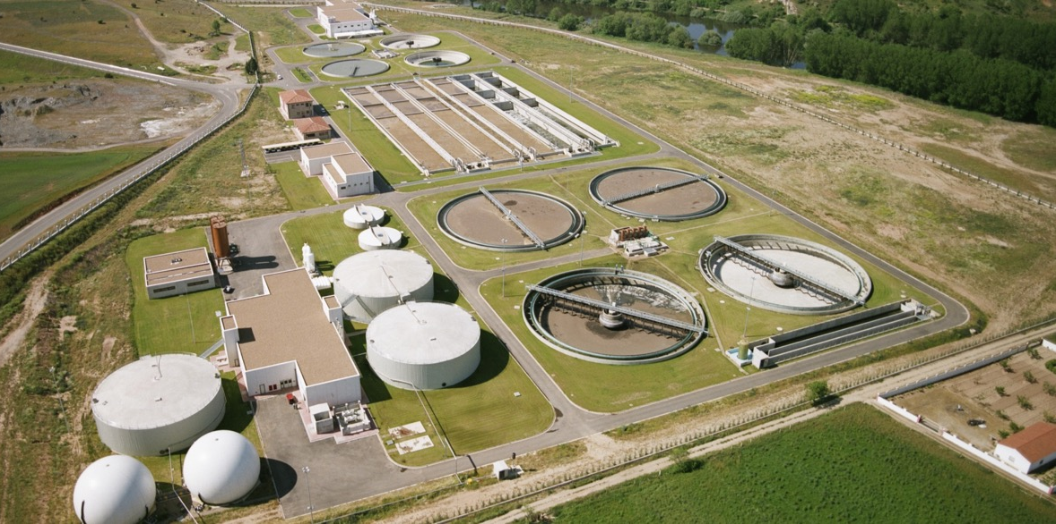
Aqualia
References in Spain
Strategic Pillars
Value chain
Key figures
International presence
Business model
Values
Key objectives and challenges
Lines of action
References
Sustainability as a strategic driver
R&D&I strategy
Digitalization
End-to-end Water Management in Salamanca
Management since 1997.
Client: Salamanca City Council.
Population: 146 110 inhabitants.
Pioneers in Spain in the application of R&D&I for the removal of nutrients from treated wastewater return flows.

Slide 32
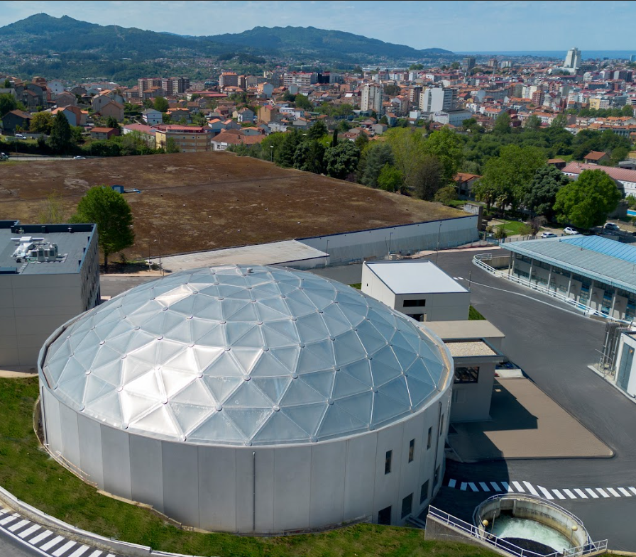
Aqualia
References in Spain
Strategic Pillars
Value chain
Key figures
International presence
Business model
Values
Key objectives and challenges
Lines of action
References
Sustainability as a strategic driver
R&D&I strategy
Digitalization
End-to-end Water Management in Vigo, Pontevedra
Management since 1990.
Client: Vigo City Council.
Population: 294 000 inhabitants.
The largest water infrastructure in Galicia.

Slide 33
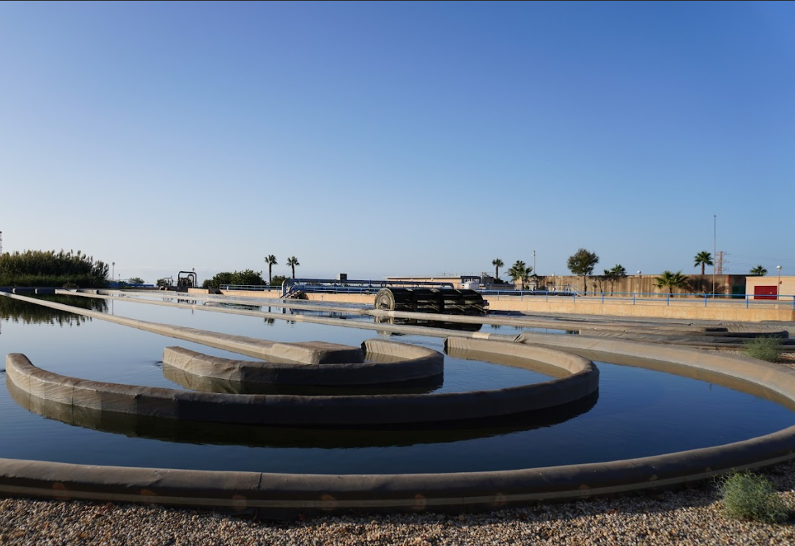
Aqualia
References in Spain
Strategic Pillars
Value chain
Key figures
International presence
Business model
Values
Key objectives and challenges
Lines of action
References
Sustainability as a strategic driver
R&D&I strategy
Digitalization
End-to-end Water Management in Almería
Management since 1993.
Client: Almería City Council.
Population: 205 468 inhabitants.
A leading water service in Spain and headquarters for several of the company’s R&D&I projects.

Slide 34
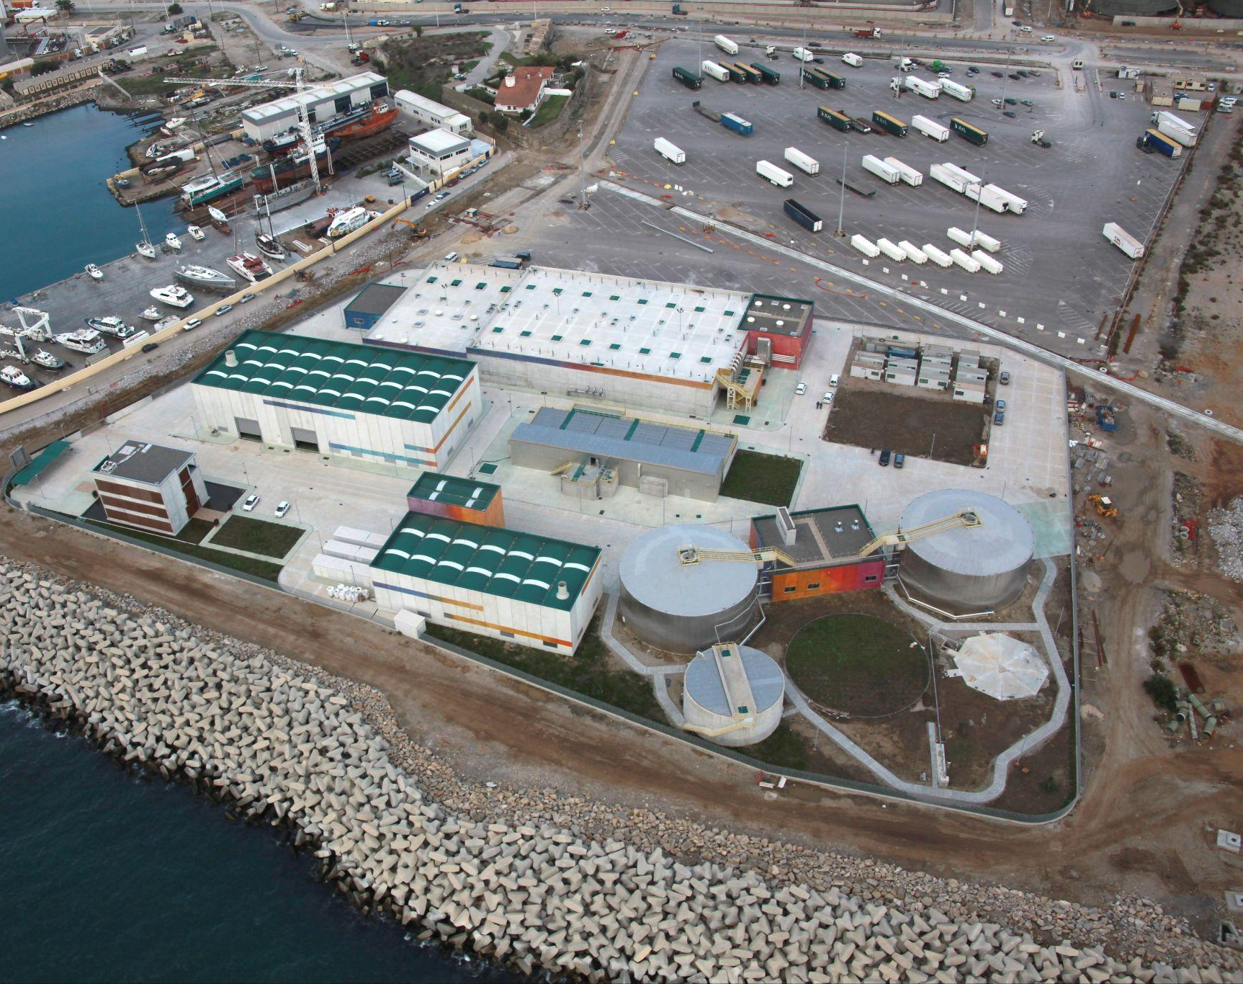
Aqualia
References in Spain
Strategic Pillars
Value chain
Key figures
International presence
Business model
Values
Key objectives and challenges
Lines of action
References
Sustainability as a strategic driver
R&D&I strategy
Digitalization
Water Supply and Sewer Services in Algeciras, Cádiz
Management since 1995.
Client: Algeciras City Council.
Population: 126 589 inhabitants.
Mixed company (Emalgesa), with Aqualia holding 49% and the City Council 51%.

Slide 35
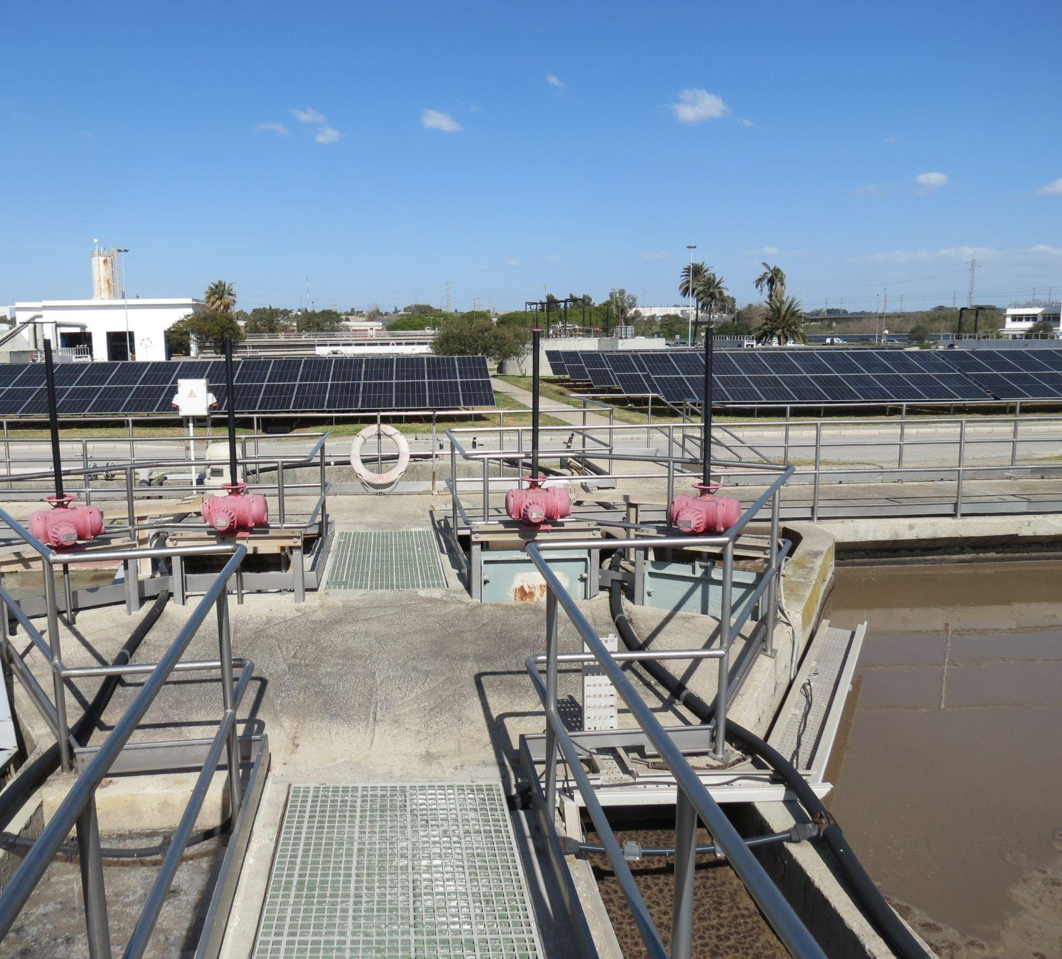
Aqualia
References in Spain
Strategic Pillars
Value chain
Key figures
International presence
Business model
Values
Key objectives and challenges
Lines of action
References
Sustainability as a strategic driver
R&D&I strategy
Digitalization
End-to-end Water Management in Jerez de la Frontera, Cádiz
Management since 2013.
Client: Jerez de la Frontera City Council.
Population: 213 634 inhabitants.
Headquarters of various R&D&I projects at the wastewater treatment plant.

Slide 36
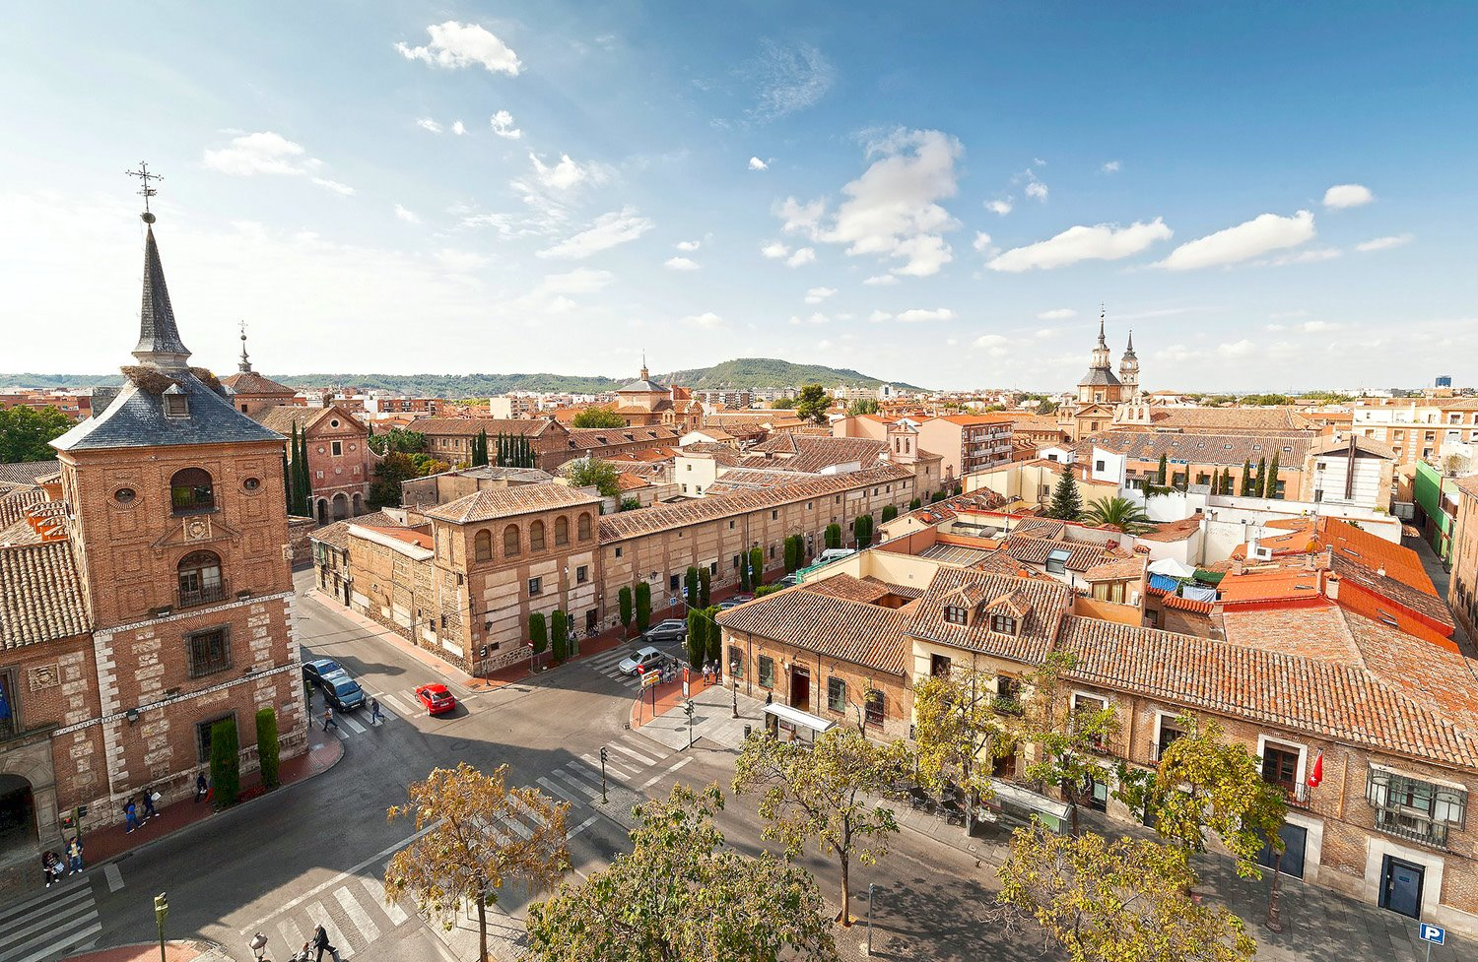
Aqualia
References in Spain
Strategic Pillars
Value chain
Key figures
International presence
Business model
Values
Key objectives and challenges
Lines of action
References
Sustainability as a strategic driver
R&D&I strategy
Digitalization
End-to-end Water Management in Alcalá de Henares, Madrid
Management since 2004.
Client: Alcalá de Henares City Council. Mixed company (Aguas de Alcalá) in which Aqualia collaborates with Canal de Isabel II.
Population: 203 208 inhabitants.

Slide 37
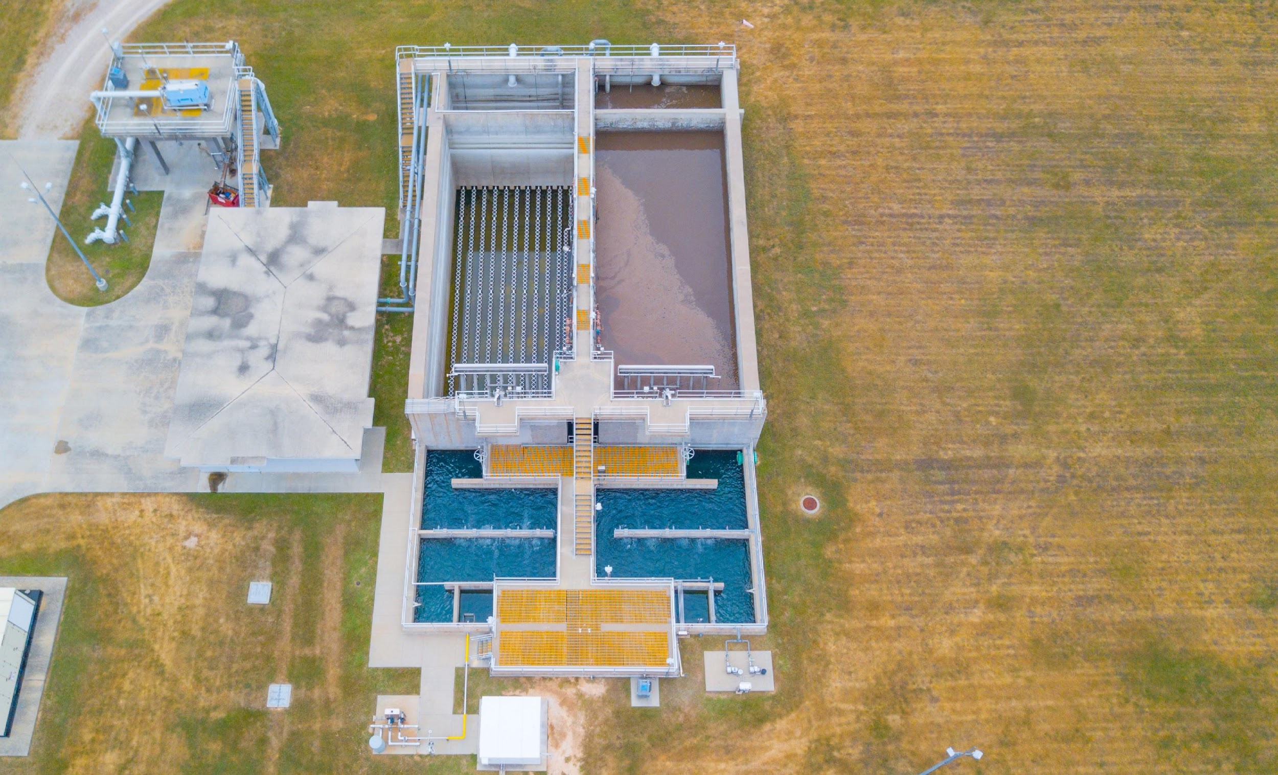
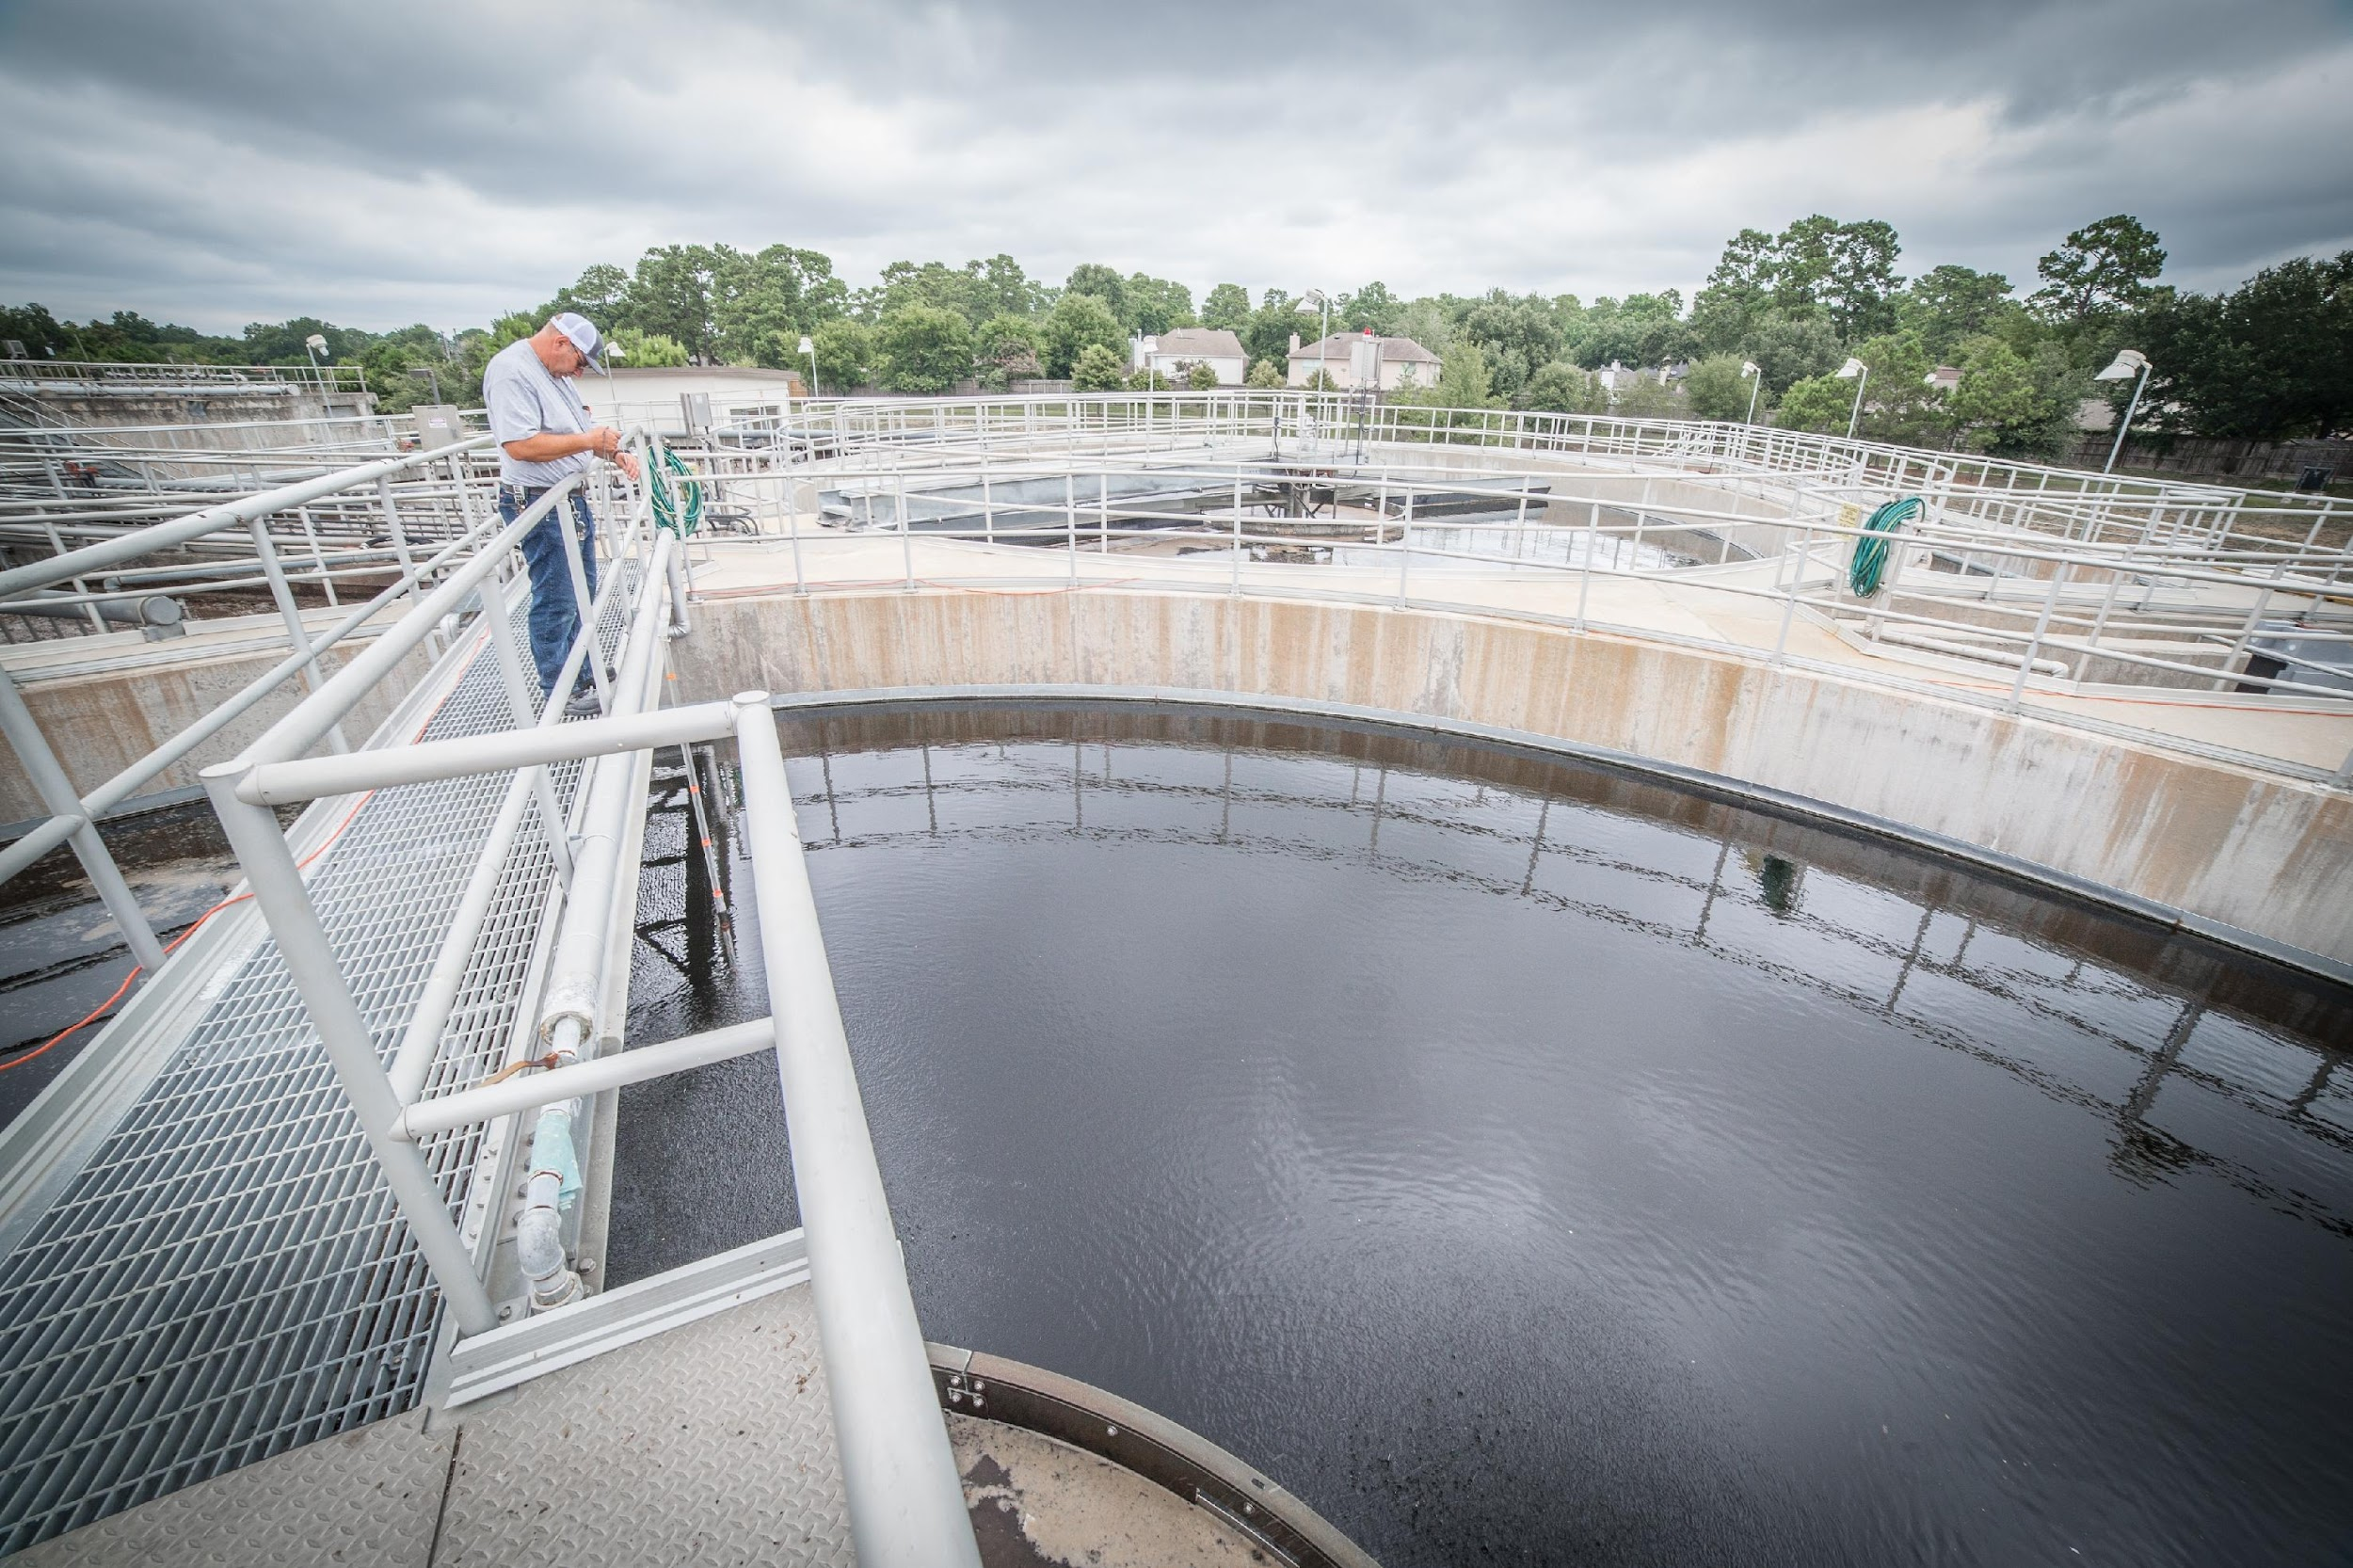
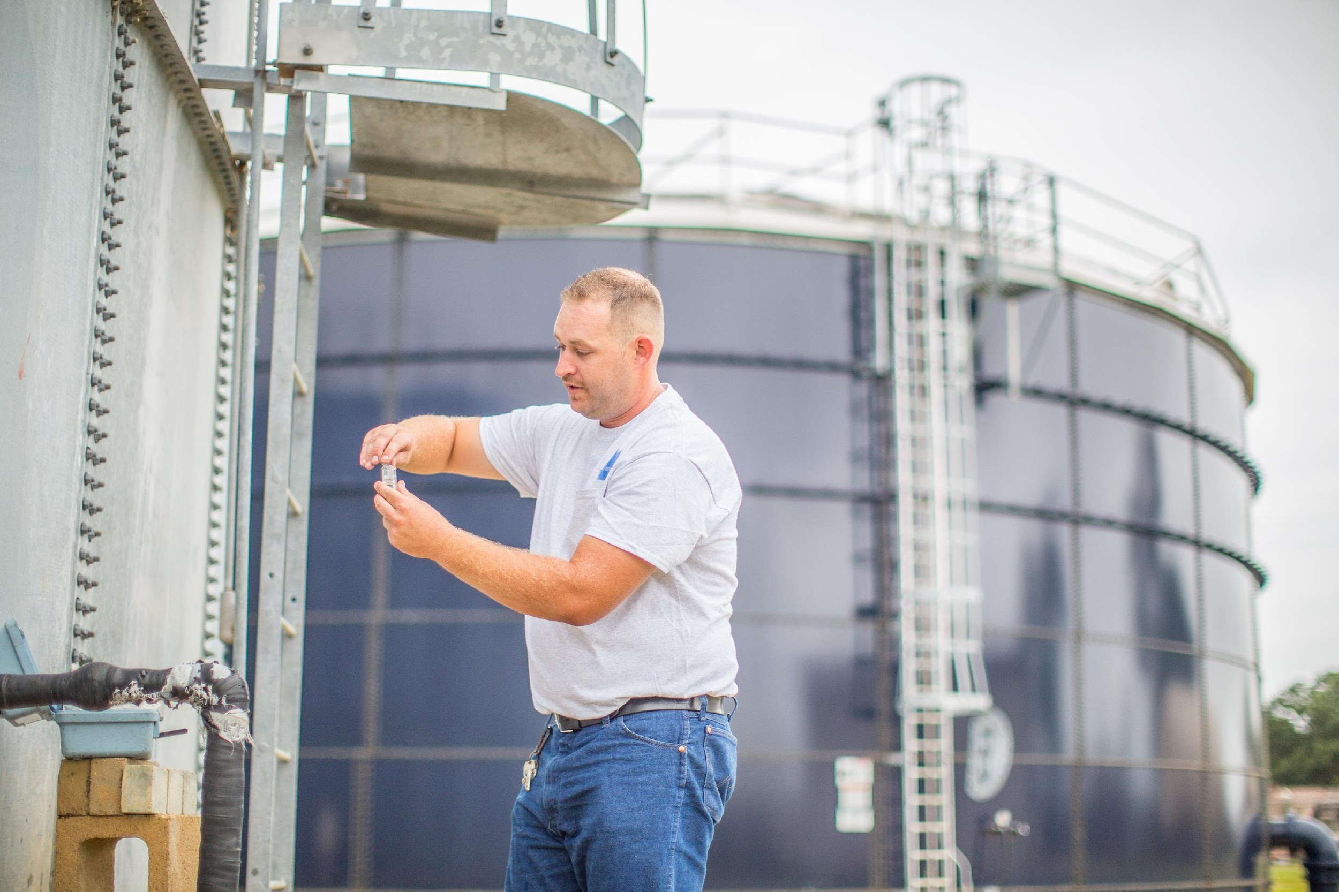
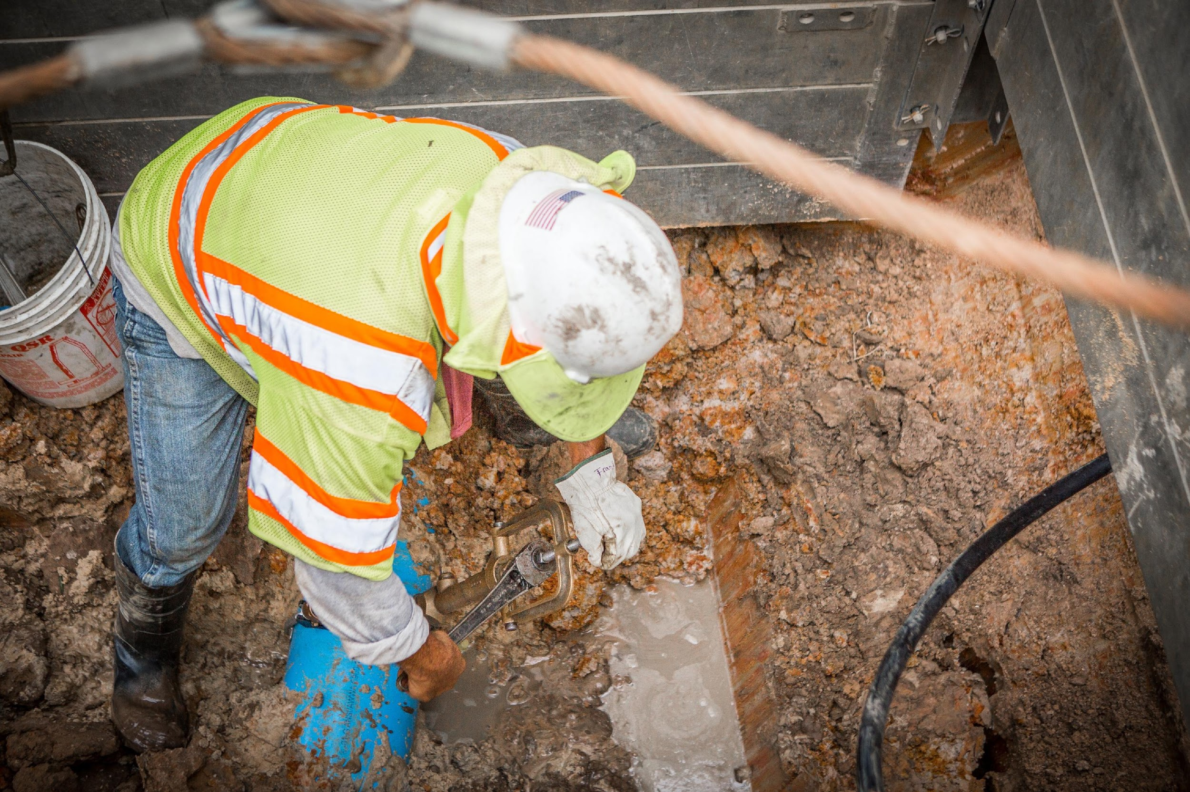
Aqualia
References in United States
Strategic Pillars
Value chain
Key figures
International presence
Business model
Values
Key objectives and challenges
Lines of action
References
Sustainability as a strategic driver
R&D&I strategy
Digitalization
Texas
Houston
End-to-end Water Management in Texas, United States
Management since 2023.
Population: 456 190 inhabitants.
The project includes the end-to-end water cycle management through 166 service contracts with Municipal Utility Districts (MUDs) in the Houston metropolitan area.

Slide 38
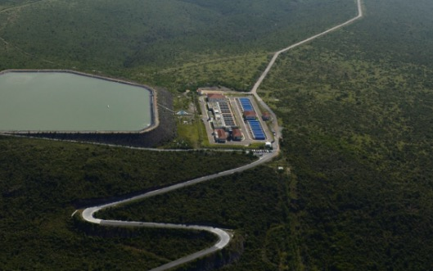
Aqualia
References in Mexico
Strategic Pillars
Value chain
Key figures
International presence
Business model
Values
Key objectives and challenges
Lines of action
References
Sustainability as a strategic driver
R&D&I strategy
Digitalization
Querétaro Aqueduct, Mexico
Management since 2011.
Project type: BOT – Build, Operate, and Transfer (20 years).
Client: State Water Commission of Querétaro (CEA).
Population: 794 790 inhabitants.
The service includes water collection and pumping, drinking water treatment, gravity conveyance, distribution, and storage. The infrastructure comprises a total of 79.5 miles of pipelines, a reservoir, a 3 miles tunnel, pumping stations, storage tanks, and a drinking water treatment plant with a production capacity of 105 acre-feet /day.

Slide 39
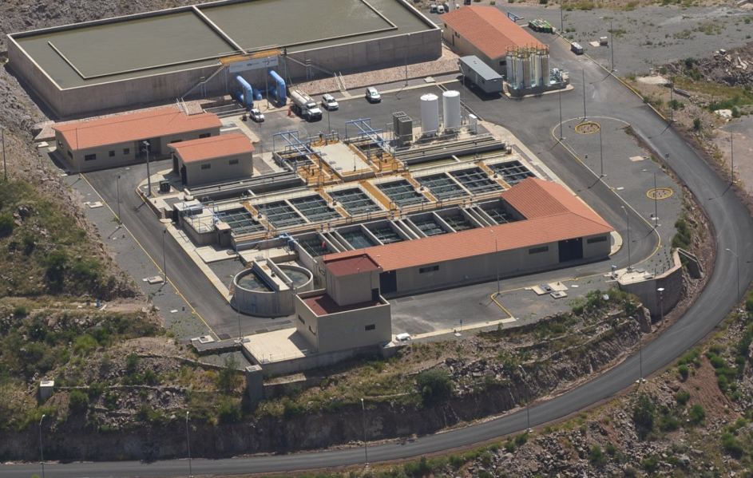
Aqualia
References in Mexico
Strategic Pillars
Value chain
Key figures
International presence
Business model
Values
Key objectives and challenges
Lines of action
References
Sustainability as a strategic driver
R&D&I strategy
Digitalization
El Realito Aqueduct, Mexico
Management since 2011.
Project Type: BOT – Build, Operate and Transfer (25 years).
Client: San Luis de Potosí State Water Commission (CEA).
Population: 911 908 inhabitants.
Water conduction and treatment from the El Realito dam to San Luis de Potosí. The project, which generates 70 acre‑feet/day, includes a total of 82 miles of conduits, pumping stations, storage tanks, and a drinking water treatment plant.

Slide 40
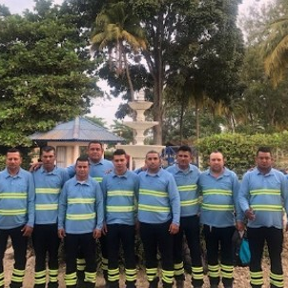
Aqualia
References in Colombia
Strategic Pillars
Value chain
Key figures
International presence
Business model
Values
Key objectives and challenges
Lines of action
References
Sustainability as a strategic driver
R&D&I strategy
Digitalization
Magdalena
Guajira
El Retén
Riohacha
San Antero
Cordoba
Atlantic
Aracataca
Purísima Concepción
Momil
Candelaria
Fundación
North of Santander
Tuchín
Galapa
Maicao
Luruaco
Albania
Lorica
San Andrés de Sotavento
Repelón
Chimá
Manatí
Cereté
Ciénaga de Oro
Santa Lucía
Villa del Rosario (Cúcuta)
San Carlos
Sahagún
Campo La Cruz
Mesa de Ruitoque (Bucaramanga)
Planeta Rica
Santander
Flandes
Tolima
Aguas de la Sabana
Bogotá Aqualia’s Headquarters in Colombia
End-to-End Water Management in Colombia
Cundinamarca
Salitre WWTP
Management since 2020.
Population: more than 1 260 486 inhabitants.
The project includes 28 municipalities spread across 8 departments.

Slide 41
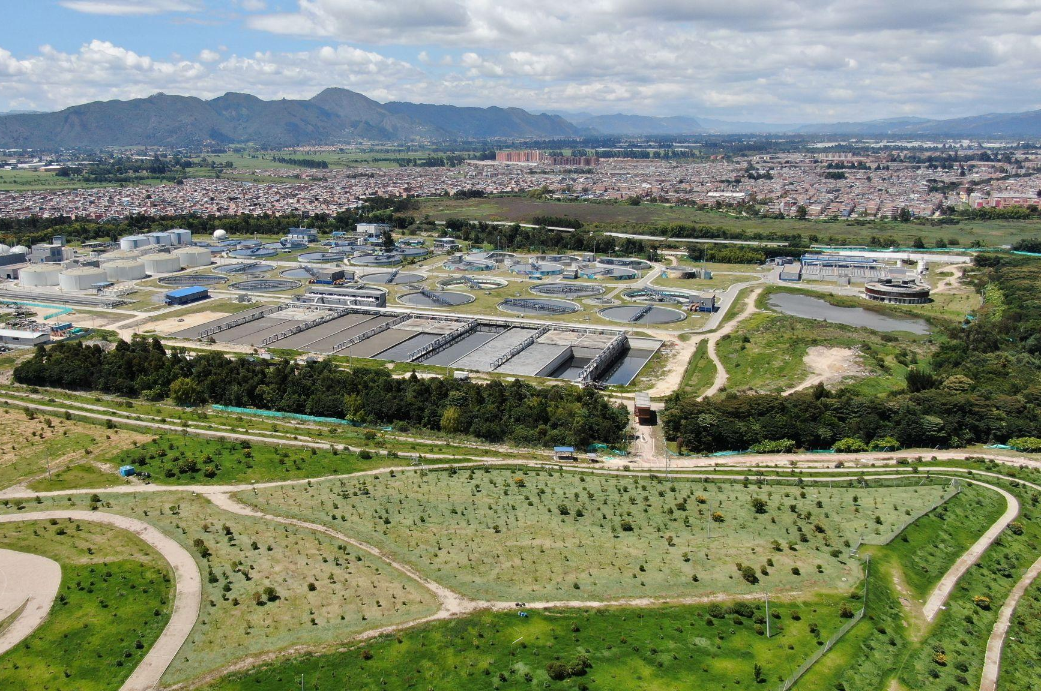
Aqualia
References in Colombia
Strategic Pillars
Value chain
Key figures
International presence
Business model
Values
Key objectives and challenges
Lines of action
References
Sustainability as a strategic driver
R&D&I strategy
Digitalization
El Salitre Wastewater Treatment Plant, Colombia
Population: more than 3 000 000 inhabitants.
Capacity: 486 acre-feet/day.
Expansion and improvement of the El Salitre Wastewater Treatment Plant in Bogotá.

Slide 42
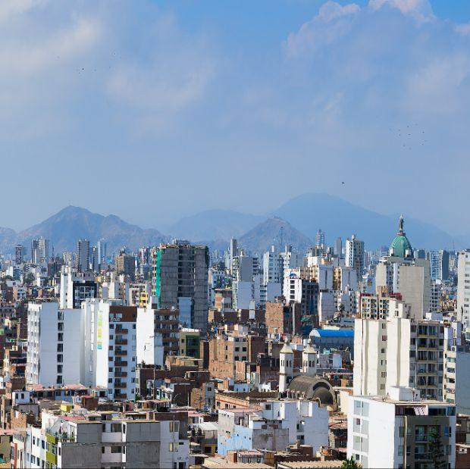
Aqualia
References in Peru
Strategic Pillars
Value chain
Key figures
International presence
Business model
Values
Key objectives and challenges
Lines of action
References
Sustainability as a strategic driver
R&D&I strategy
Digitalization
End-to-End Water Management in Chincha, Peru
Project Type: design, financing, construction, operation, and maintenance (24 years).
Population: more than 345 000 inhabitants.
The project includes the execution and operation of 13 miles of collection networks, a pumping station, wastewater treatment plants, and 4.8 miles of lines for the final disposal of treated water.
The new infrastructure will reduce diseases caused by untreated wastewater, improving public health and the quality of life for the inhabitants of the affected districts. It will also enhance the circular economy in the region and provide a new source of water for agricultural and/or industrial use.
Province of Chincha

Slide 43
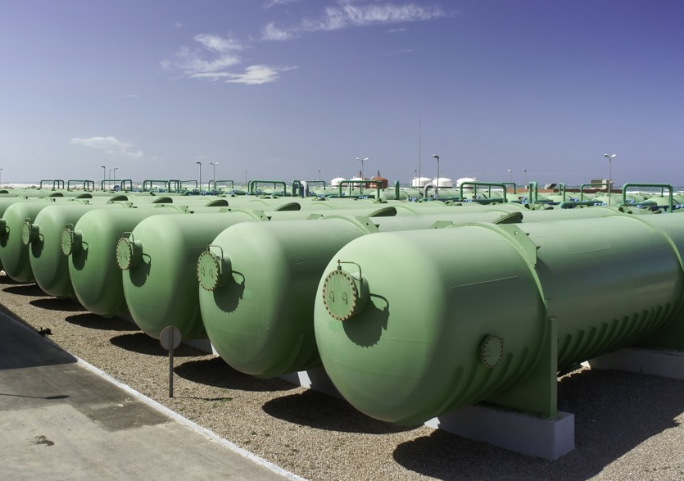
Aqualia
References in Algeria
Strategic Pillars
Value chain
Key figures
International presence
Business model
Values
Key objectives and challenges
Lines of action
References
Sustainability as a strategic driver
R&D&I strategy
Digitalization
Mostaganem Desalination Plant, Algeria
Client: SONATRACH/AEC.
Project Type: Design and Construction (completed in 2012), and Operation and Maintenance through Public-Private Partnership. Population: more than 1 200 000 inhabitants.
Capacity: 162 acre-feet/day.
One of the largest desalination plants in Africa.
43

Slide 44
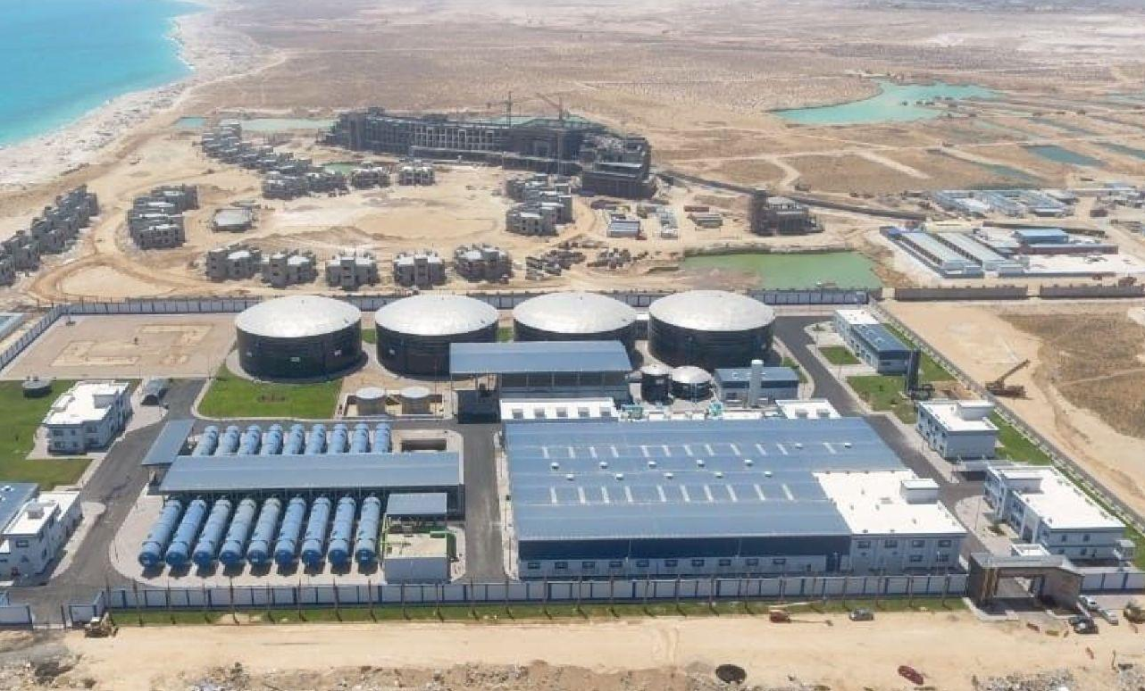
Aqualia
References in Egypt
Strategic Pillars
Value chain
Key figures
International presence
Business model
Values
Key objectives and challenges
Lines of action
References
Sustainability as a strategic driver
R&D&I strategy
Digitalization
El Alamein Desalination Plant, Egypt
Client: Ministry of Defense.
Project Type: Design and Construction (completed in 2019), and Operation and Maintenance (through 2027).
Population: 1 000 000 inhabitants.
Capacity: 121.6 acre-feet/day.
First and only desalination plant executed by a single company, and moreover, a Spanish company. One of the top 3 plants in the world in 2020 according to GWI and the best in Egypt.

Slide 45
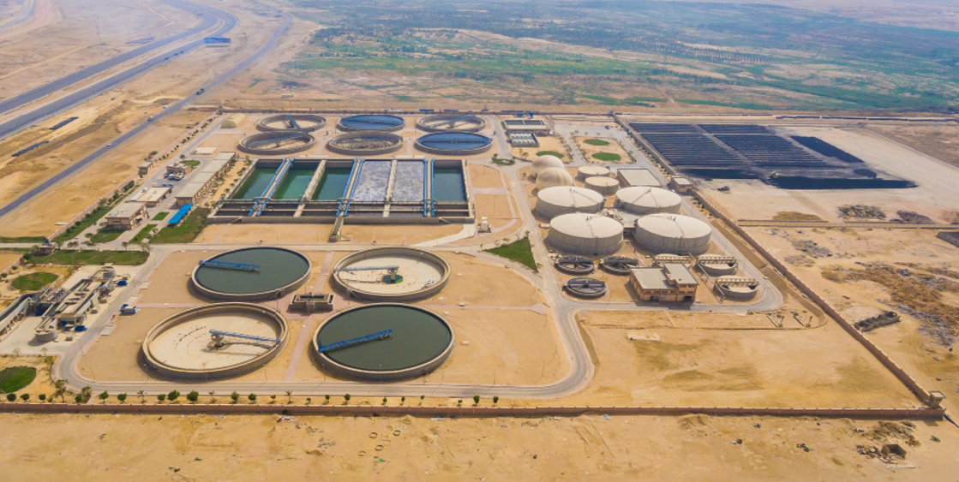
Aqualia
References in Egypt
Strategic Pillars
Value chain
Key figures
International presence
Business model
Values
Key objectives and challenges
Lines of action
References
Sustainability as a strategic driver
R&D&I strategy
Digitalization
New Cairo Wastewater Treatment Plant, Egypt
Management since 2009.
Client: NUCA (Ministry of Housing).
Project Type: Financing, Design and Construction (completed in 2013), and Operation and Maintenance (18 years).
Population: 1 500 000 inhabitants.
Capacity: 202.7 acre-feet/day.
First Public-Private Partnership project in Egypt.

Slide 46
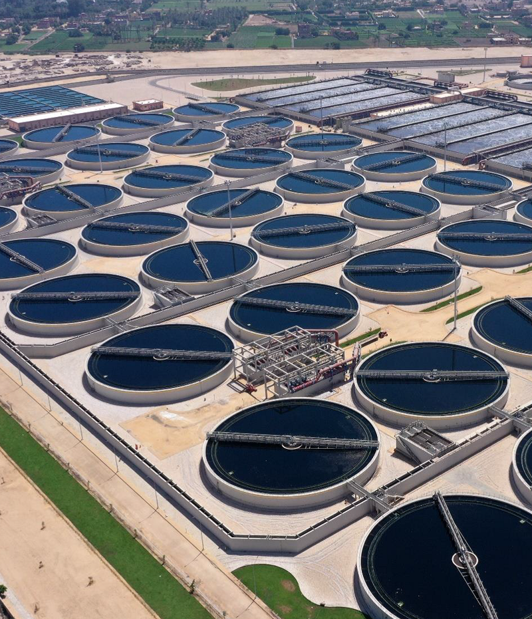
Aqualia
References in Egypt
Strategic Pillars
Value chain
Key figures
International presence
Business model
Values
Key objectives and challenges
Lines of action
References
Sustainability as a strategic driver
R&D&I strategy
Digitalization
Abu Rawash Wastewater Treatment Plant, Egypt
Client: CAPW (Ministry of Housing). Project type: Design and construction (ongoing), and Operation and Maintenance.
Population: 8 500 000 inhabitants.
Capacity: 1 297 acre-feet/day.
Largest EPC (Engineering, Procurement and Construction) of a biological plant in Africa.

Slide 47
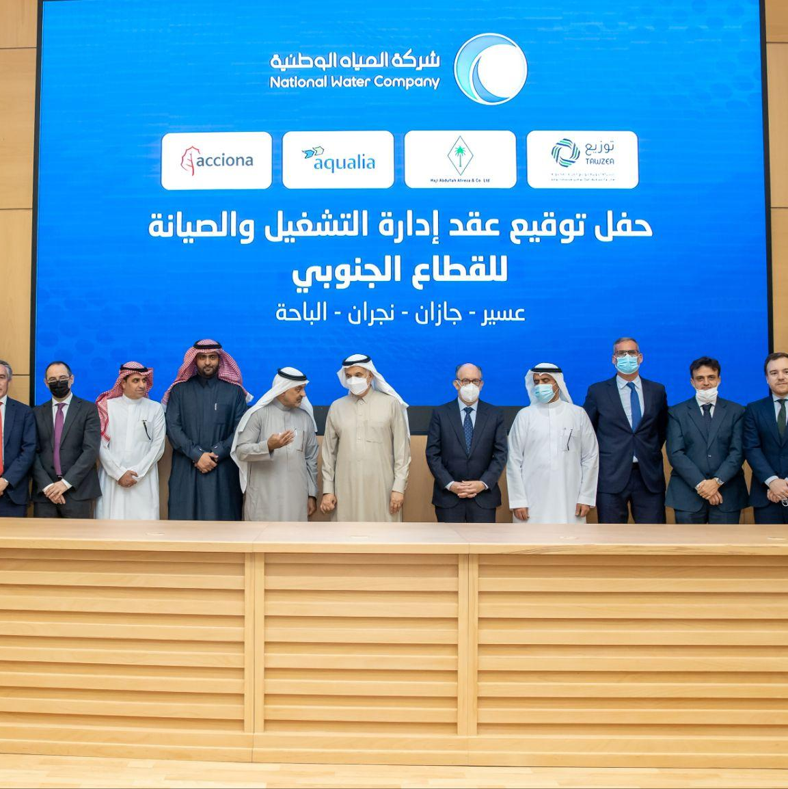
Aqualia
References in Saudi Arabia
Strategic Pillars
Value chain
Key figures
International presence
Business model
Values
Key objectives and challenges
Lines of action
References
Sustainability as a strategic driver
R&D&I strategy
Digitalization
End-to-End Water Management and O&M in Saudi Arabia
North Cluster Contract
Bahri Floating Barges SWRO Desalination Plant
Management since 2020.
Project type: Management, Operation and Maintenance.
Population: 8 815 518 inhabitants.
The project includes 631 municipalities spread across 8 provinces in the Northern and Southern Clusters of Arabia: Assir, Jizan, Al Baha, Najran, Qassim, Hail, Al Jouf, and Northern Borders.
MUWDC Rabigh MED Desalination Plant
KAUST SWRO Desalination Plant
KAIA SWRO Desalination Plant
Marafiq Jizan SWRO Desalination Plant
South Cluster Contract

Slide 48
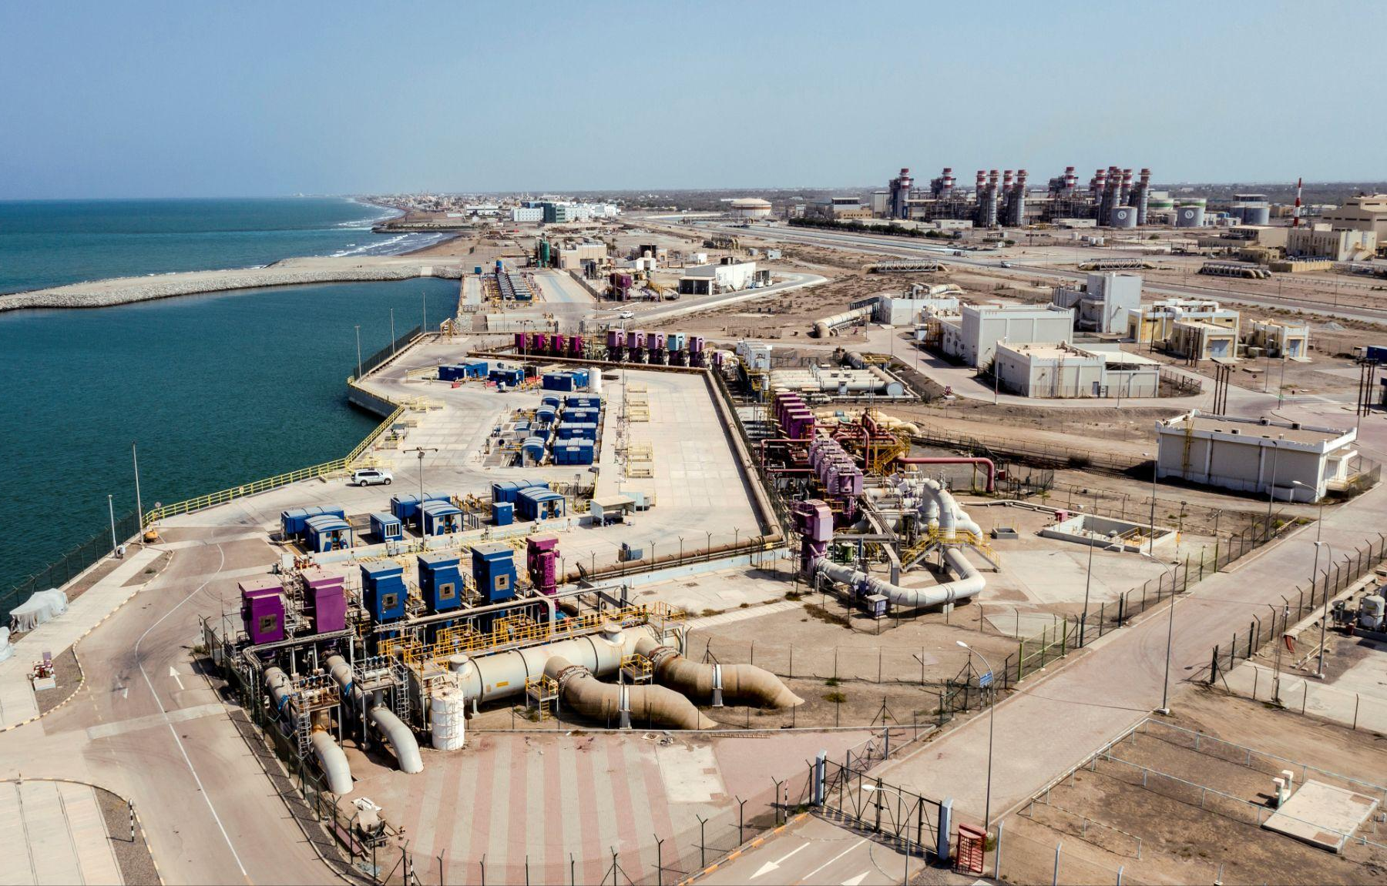
Aqualia
References in Oman
Strategic Pillars
Value chain
Key figures
International presence
Business model
Values
Key objectives and challenges
Lines of action
References
Sustainability as a strategic driver
R&D&I strategy
Digitalization
Hydraulic Installations of Sohar Port, Oman
Client: MAJIS INDUSTRIAL SERVICES (Government of Oman).
Project type: O&M – Operation and Maintenance (20 years).
This project includes numerous infrastructures for water collection and pumping, desalination, supply, treatment, and sewer in the end-to-end water cycle.

Slide 49
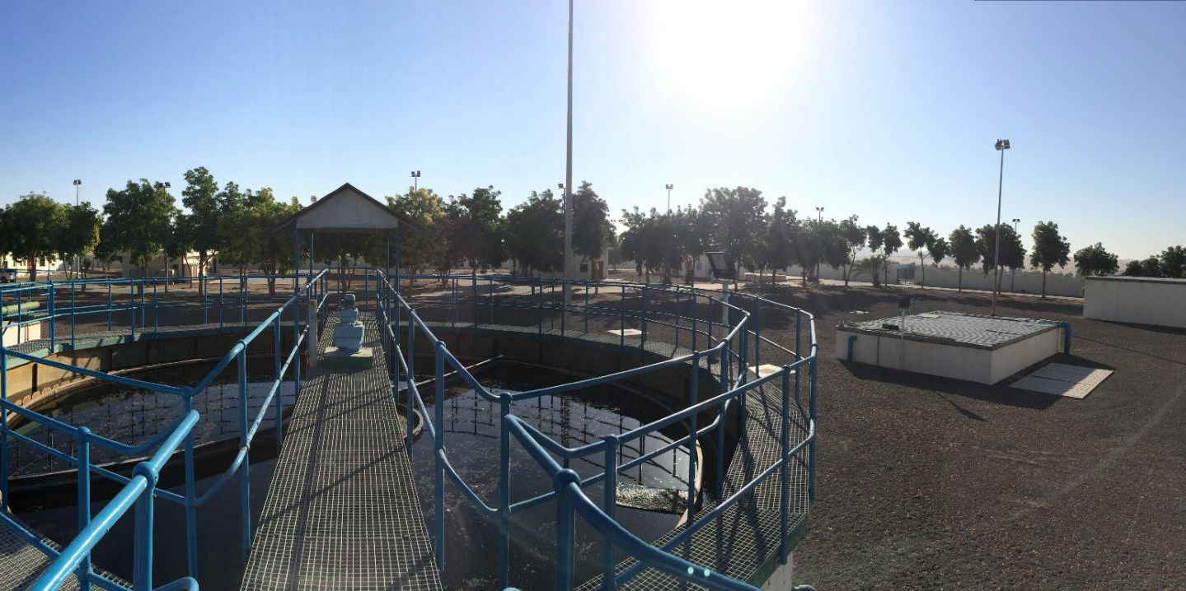
Aqualia
References in United Arab Emirates
Strategic Pillars
Value chain
Key figures
International presence
Business model
Values
Key objectives and challenges
Lines of action
References
Sustainability as a strategic driver
R&D&I strategy
Digitalization
End-to-End Water Cycle Management in Al Ain, United Arab Emirates
Management since 2012.
Project type: Water treatment and sewer system.
The initial contract established a seven-year period, until 2019, valued at 89.65 M$. Extension for 7 years.

Slide 50
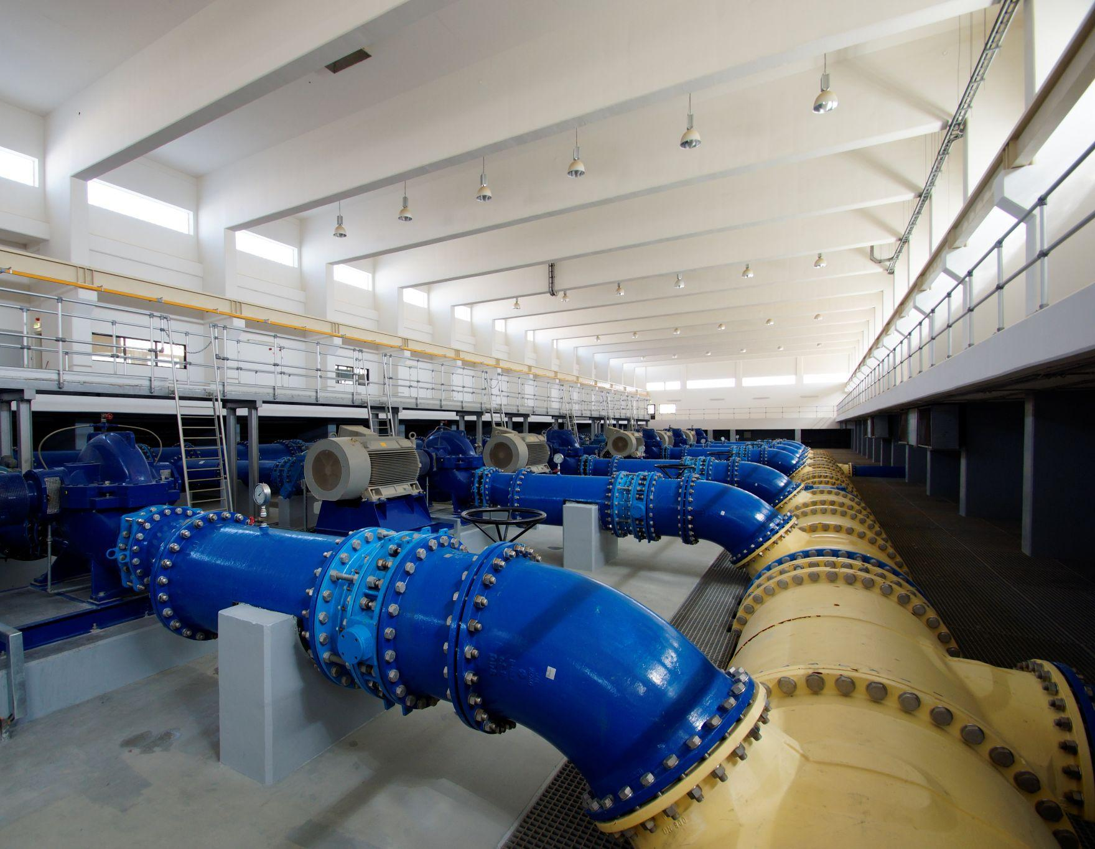
Aqualia
References in United Arab Emirates
Strategic Pillars
Value chain
Key figures
International presence
Business model
Values
Key objectives and challenges
Lines of action
References
Sustainability as a strategic driver
R&D&I strategy
Digitalization
End-to-end Water Management in Abu Dabi and some islands, United Arab Emirates
Management since 2019.
Project type: MWC – End-to-end Water Cycle (7 years) of Abu Dhabi and the adjacent islands of Al Reem, Al Maryah and Al Saadiyat.
Capacity: up to 227 acre-feet/day (more than 100 billion liters per year).
The project manages 821 miles of networks and 54 wastewater pumping stations in Abu Dhabi and the adjacent islands of Al Reem, Al Maryah, and Al Saadiyat.

Slide 51
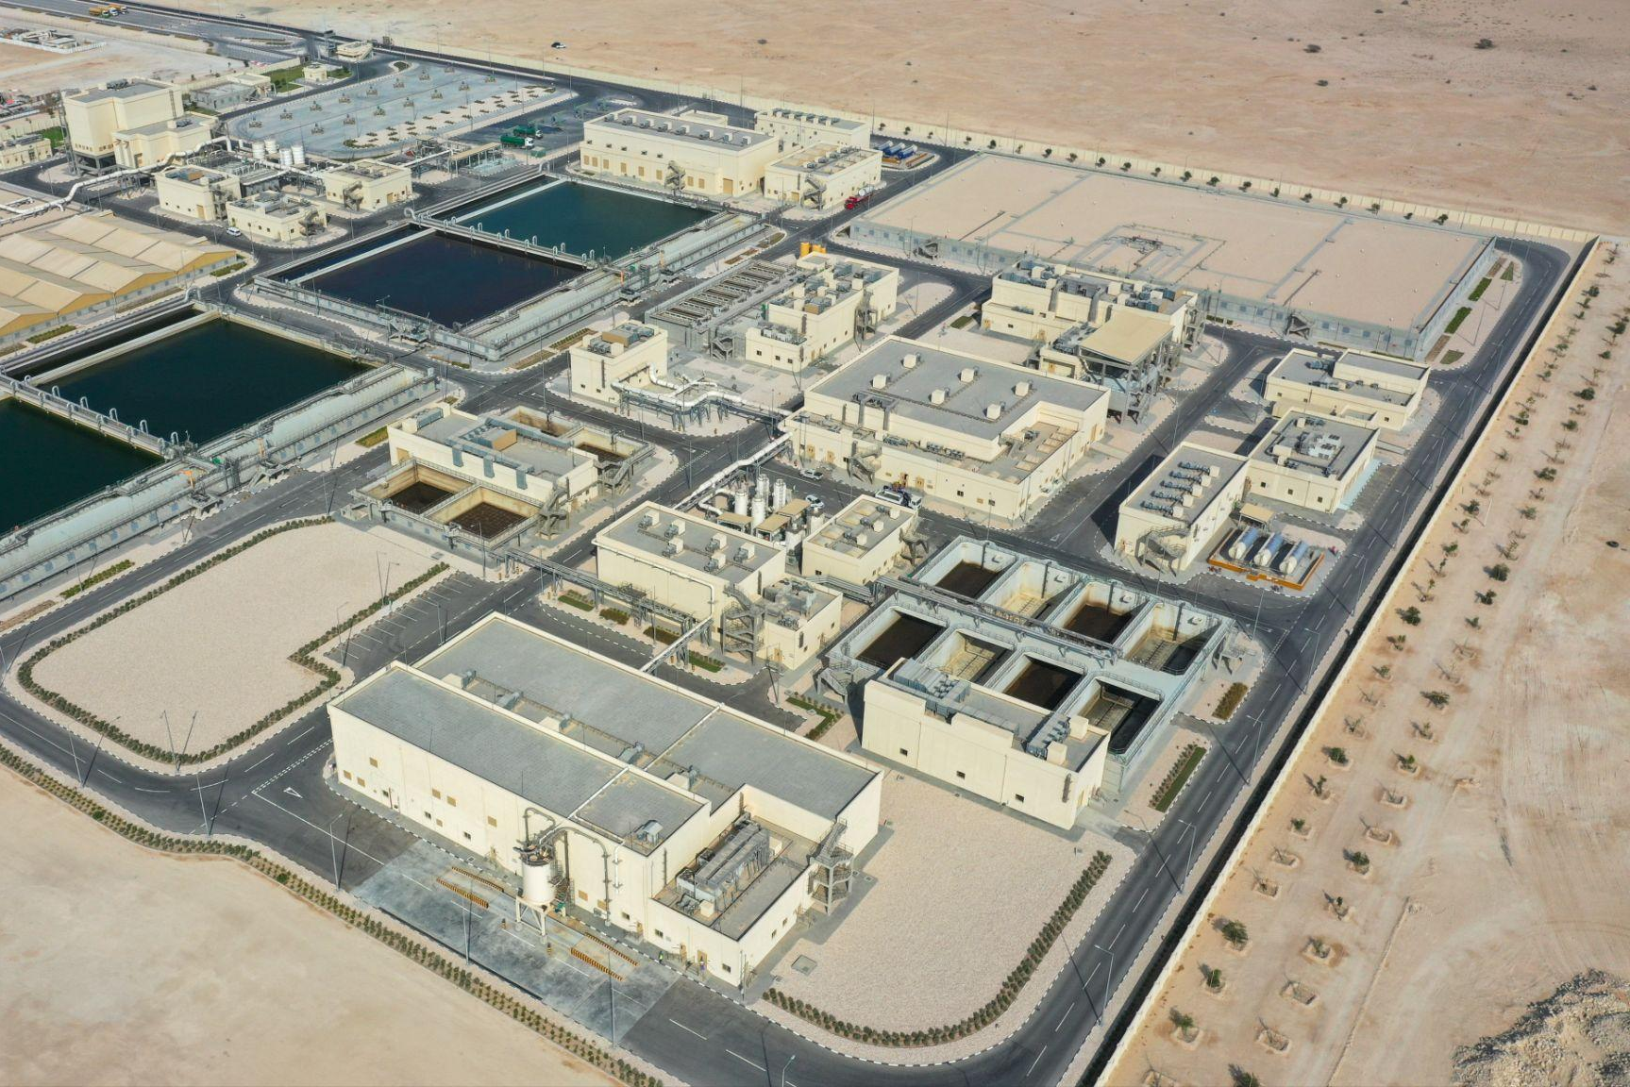
Aqualia
References in Qatar
Strategic Pillars
Value chain
Key figures
International presence
Business model
Values
Key objectives and challenges
Lines of action
References
Sustainability as a strategic driver
R&D&I strategy
Digitalization
Al-Dhakhira Wastewater Treatment Plant in Qatar
Management since 2022.
Client: Public Works Authority (Government of Qatar).
Project type: Design, Construction, Operation, and Maintenance.
Population: more than 280 000 inhabitants.
Capacity: 45.6 acre-feet/day.

Slide 52
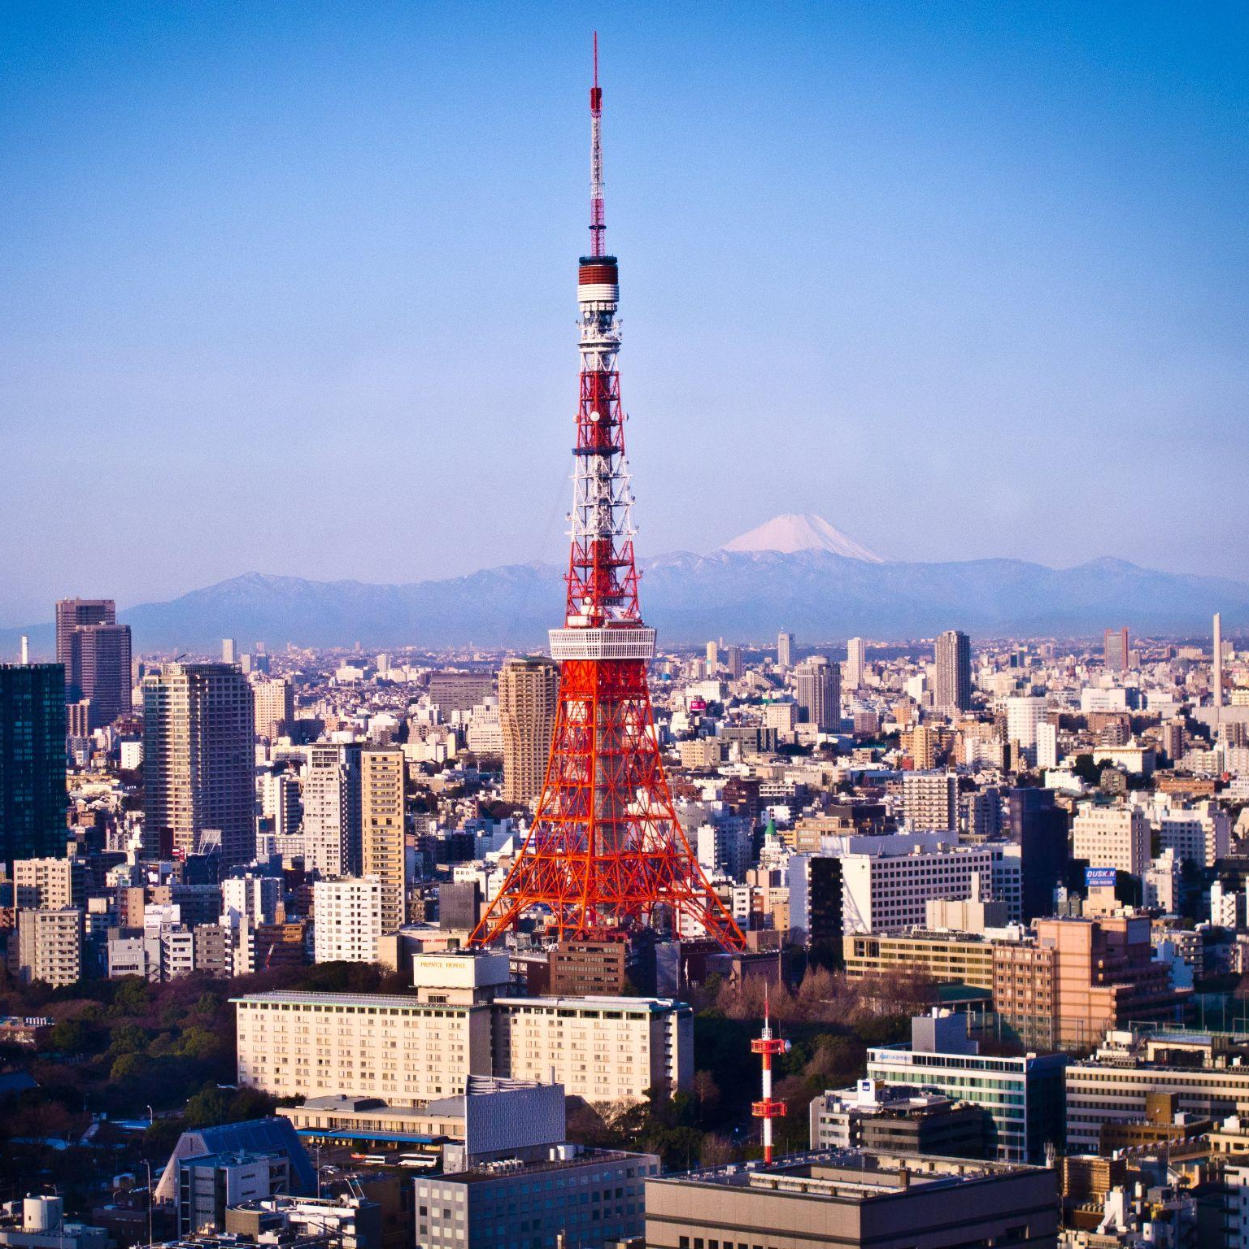
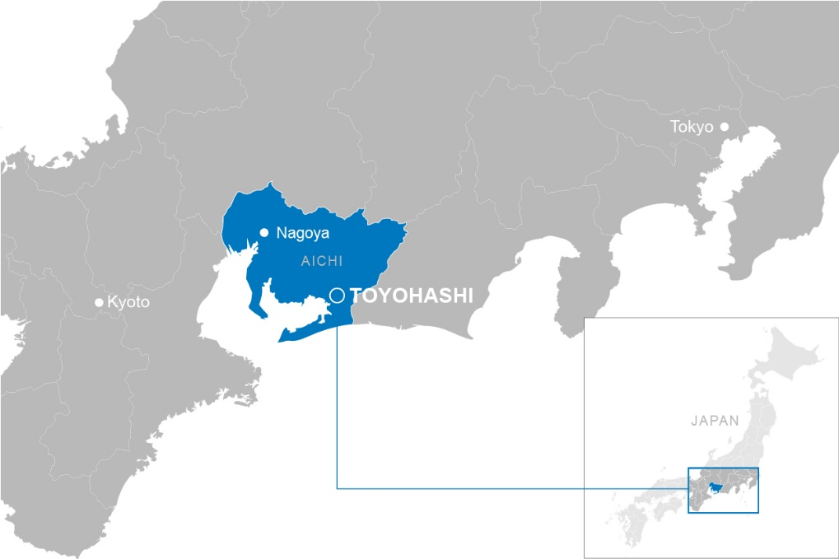
Aqualia
References in Japan
Strategic Pillars
Value chain
Key figures
International presence
Business model
Values
Key objectives and challenges
Lines of action
References
Sustainability as a strategic driver
R&D&I strategy
Digitalization
Renovation and Operation of the Toyohashi Drinking Water Treatment Plant, Japan
Management since 2025.
Population: 377 453 inhabitants.
The project involves the renovation of the Toyohashi water treatment plant and the 30‑year operation of two drinking water treatment plants in Aichi Prefecture. Delivered through a consortium led by Infroneer Holdings Co., Ltd., a Japanese group specializing in infrastructure construction and management, the project combines a Build and Transfer (BT) model with a concession system and public‑private partnership, ensuring a sustainable and resilient service.

Slide 53
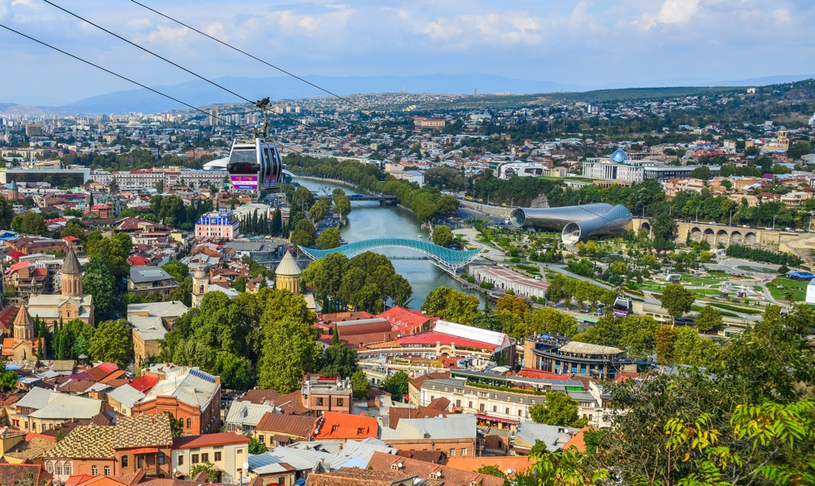
Aqualia
References in Georgia
Strategic Pillars
Value chain
Key figures
International presence
Business model
Values
Key objectives and challenges
Lines of action
References
Sustainability as a strategic driver
R&D&I strategy
Digitalization
End-to-End Water Cycle Management in Georgia
Management since 2022.
Population: 1 468 950 inhabitants.
The project includes infrastructures in 35 municipalities of Tiflis, Miskheta, Rustavi and Gardabani, including: the Zhinvali dam and reservoir (with a capacity of 421 564 acre-feet), 7 drinking water treatment plants, a wastewater treatment plant, 58 pumping stations, 118 tanks, 2 671 miles of distribution networks, and 1 056 miles of sewer networks.
53

Slide 54
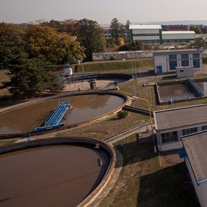
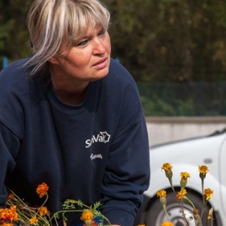

Aqualia
References in Czech Republic
Strategic Pillars
Value chain
Key figures
International presence
Business model
Values
Key objectives and challenges
Lines of action
References
Sustainability as a strategic driver
R&D&I strategy
Digitalization
End-to-End Water Cycle Management in Ostrava, Czech Republic
Population: 1 223 907 inhabitants.
Capacity: 227 acre-feet/day.
The main operator in Moravia and Silesia, managing the sewer network in 76 municipalities with a total of 1 146 miles, a supply network of 3 145 miles, 3 large water treatment plants, 68 wastewater treatment plants, and 157 pumping stations.
The project is one of the few cases of cross-border water supply, serving 100 000 inhabitants in Poland.

Slide 55
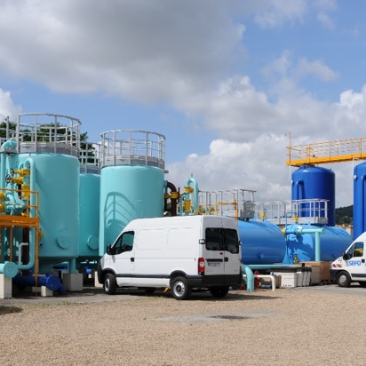
Aqualia
References in France
Strategic Pillars
Value chain
Key figures
International presence
Business model
Values
Key objectives and challenges
Lines of action
References
Sustainability as a strategic driver
R&D&I strategy
Digitalization
Agence
Aubergenville (78)
Agence
Retiers. Ile et Vilaine (35)
Agence
L'Isle-Adam (95)
Agence
Uzel (22)
Agence
Goussainville (95)
Secteur Aqualia
Rennes (35)
Agence SAAPD
Dreux, Eure-et-Loir (28)
Agence
Rambouillet (78)
Secteur
Lyon (69)
Agence
Loiret (45)
Siège
Neuilly-sur-Seine (92)
Agence
Andrésy (78)
End-to-End Water Cycle Management in Île de France and Brittany, France
Management since 2019.
Population: 820 482 inhabitants.
Management of water supply in 101 municipalities and management of sewer or wastewater treatment networks in another 100 municipalities.

Slide 56
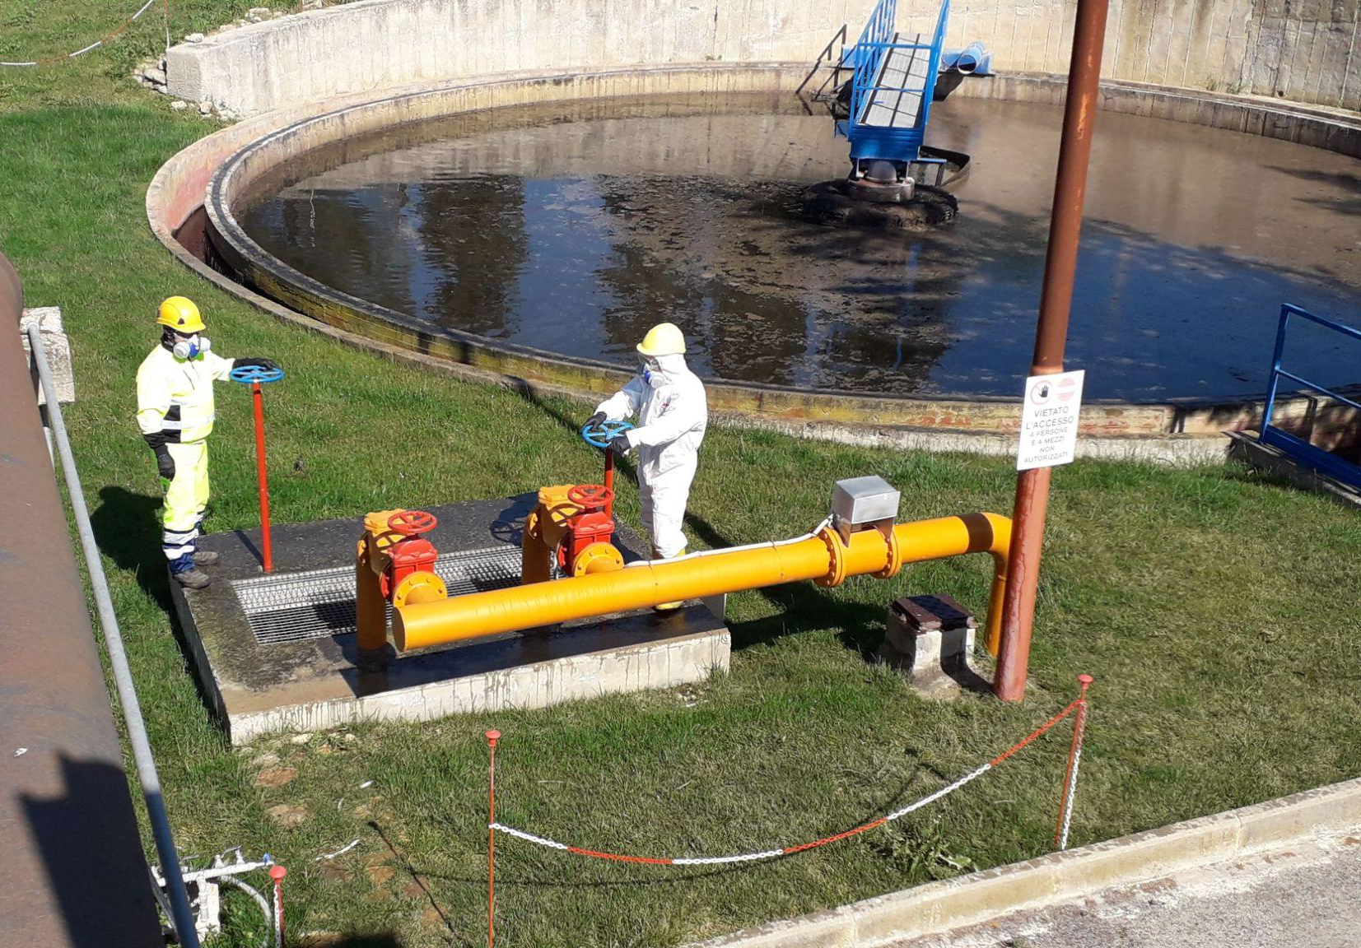
Aqualia
References in Italy
Strategic Pillars
Value chain
Key figures
International presence
Business model
Values
Key objectives and challenges
Lines of action
References
Sustainability as a strategic driver
R&D&I strategy
Digitalization
End-to-End Water Cycle Management in Caltanissetta, Italy
Management since 2006.
Population: 249 431 inhabitants.
Management of the end-to-end water cycle in 22 municipalities of the province of Caltanissetta in Sicily. The project includes a water network of 617 miles, a pipeline network of 112 miles, a sewer network of 483 miles, 21 wells, 21 wastewater treatment plants, a drinking water treatment plant, and 42 tanks.
56

Slide 57
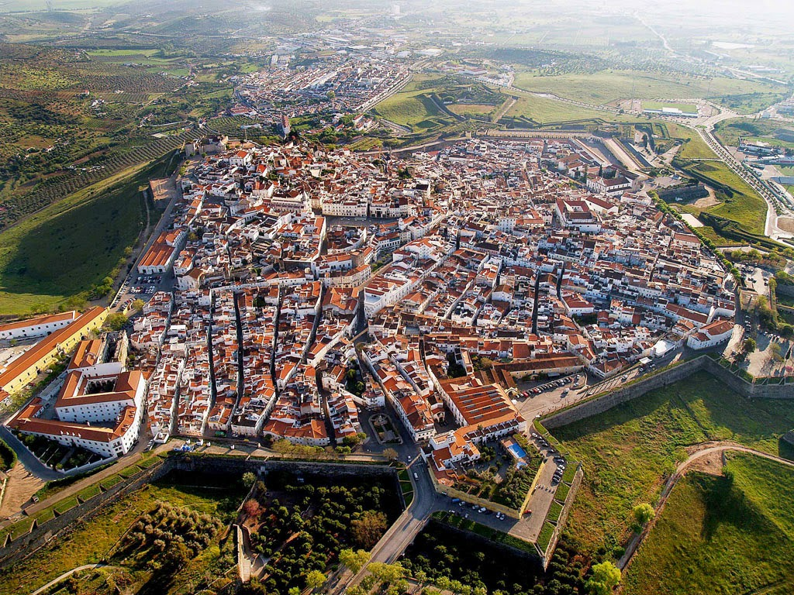
Aqualia
References in Portugal
Strategic Pillars
Value chain
Key figures
International presence
Business model
Values
Key objectives and challenges
Lines of action
References
Sustainability as a strategic driver
R&D&I strategy
Digitalization
End-to-End Water Cycle Management in Elvas, Portugal
Management since 2009.
Population: 20 412 inhabitants.
Management of more than 12 500 drinking water and wastewater treatment contracts in the municipalities of Elvas, Vila Boim, Terrugem, Vila Fernando, Barbacena, São Vicente, and Santa Eulália.
57

Slide 58


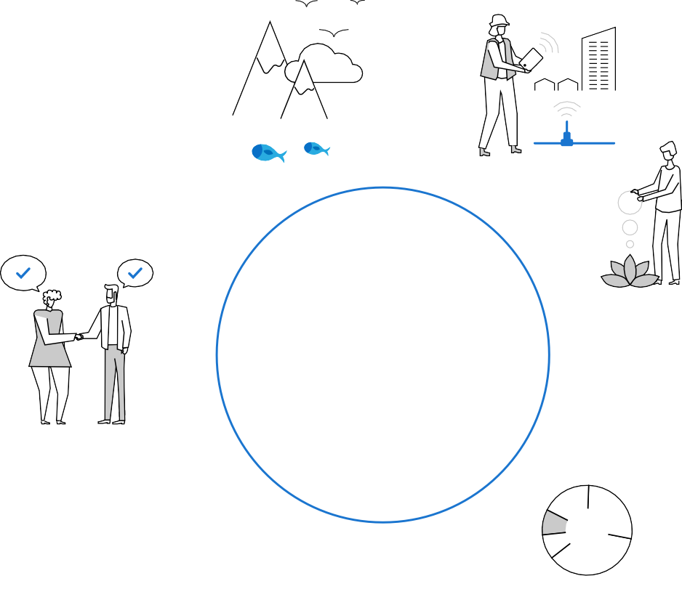










Aqualia
Sustainability as a strategic driver
Strategic Pillars
Value chain
Key figures
International presence
Business model
Values
Key objectives and challenges
Lines of action
References
Sustainability as a strategic driver
R&D&I strategy
Digitalization
A Sustainability‑Native Company
The Aqualia Sustainability Strategic Plan 2024-2026 sets out a cross‑cutting roadmap with positive impact, structured around seven lines of action aimed at ensuring the wellbeing and progress of people and communities through sustainable water management.
This approach strengthens Aqualia’s capabilities in efficient water management, technological innovation, and adaptation to local needs.
At the same time, it enables the generation of shared value, improving community quality of life, ensuring the sustainable profitability of operations, and facilitating access to financing linked to ESG criteria.
Through this Plan, sustainability is consolidated as a key lever for Aqualia’s leadership and positioning in an increasingly demanding and competitive global environment.
Business Model and Strategy for Quality Service
Pillars
Sustainability
Digitalization and Technology
Internationalization
Aqualia Sustainability Strategic Plan 2024–2026
Strategic Lines
SL1 CLIMATE EMERGENCY AND PLANET CARE
Its purpose is to implement initiatives to help adapt Aqualia to climate change and reduce its impact on biodiversity.
SL2 TECHNOLOGY FOR INTEGRATED MANAGEMENT
Its focus is on the implementation of digitalization across the entire end-to-end water cycle to enable efficient management.
SL7 PARTNERSHIPS FOR GENERATING POSITIVE IMPACT
This strategic line establishes mechanisms to create partnerships that generate positive impact through collaborative leadership. It is aligned with global challenges and contributes to the Sustainable Development Goals (SDGs).
Providers of Essential Services
End-to-end Water Cycle Management (MWC) Infrastructure Concessions (BOT) Operation and Maintenance (O&M)Technology and Networks (EPC) Aqualia Industrial
SL3 PEOPLE MANAGEMENT
This strategic line focuses on promoting people’s physical and emotional wellbeing and on building a sustainable organizational identity.
At Aqualia, sustainability is a strategic pillar of competitiveness and growth, fully integrated into the business model.
SL6 STRATEGIC COMMUNICATION
Its development highlights Aqualia’s performance and connects the company’s different realities and contexts.
SL4 FINANCIAL AND BUSINESS STRATEGY
Its purpose is to achieve sustainable growth, based on reasonable profitability criteria and the integration of Aqualia’s capabilities across the value chain.
SL5 ETHICS AND COMPLIANCE
Through this strategic line, the goal is to embed Aqualia’s culture and values across the entire company and throughout the supply chain.

Slide 59







Aqualia
R&D&I in Aqualia
Strategic Pillars
Value chain
Key figures
International presence
Business model
Values
Key objectives and challenges
Lines of action
References
Sustainability as a strategic driver
R&D&I strategy
Digitalization
Our R&D&I strategy focuses on identifying opportunities and developing and implementing solutions to address the environmental, social, technological, and legislative challenges of end-to-end water management. Internal and external collaboration is key to knowledge transfer and its contribution to sustainable development.
Sustainable wastewater treatment
These nature-based solutions (aerobic technologies) offer low-cost options with good performance in line with European regulations on urban wastewater treatment.
Industrial water
Industrial activity must become increasingly sustainable: we provide solutions for industrial clients to adapt water use in their processes and optimize the treatment of their effluents.
Circular economy, eco and biofactories
Solutions for waste utilization and transformation of WWTP into eco and biofactories, which minimize energy and reagent consumption, avoid waste production, and generate new products.
Energy efficiency
Utilization of wastewater as an energy source and search for other renewable sources, such as the transformation of organic matter into bioenergy (biomethane, hydrogen) in WWTP.
Digital developments
Advanced technology to improve water cycle management: Internet of Things, interconnection of multiple sensors, data analysis, AI. This combination of elements allows for early problem detection, rapid response, and process optimization.
Reuse, drinking water treatment, and desalination
In response to the problem of water stress, drinking water treatment and wastewater reuse solutions adapted to population size and water quality required by regulation.

Slide 60

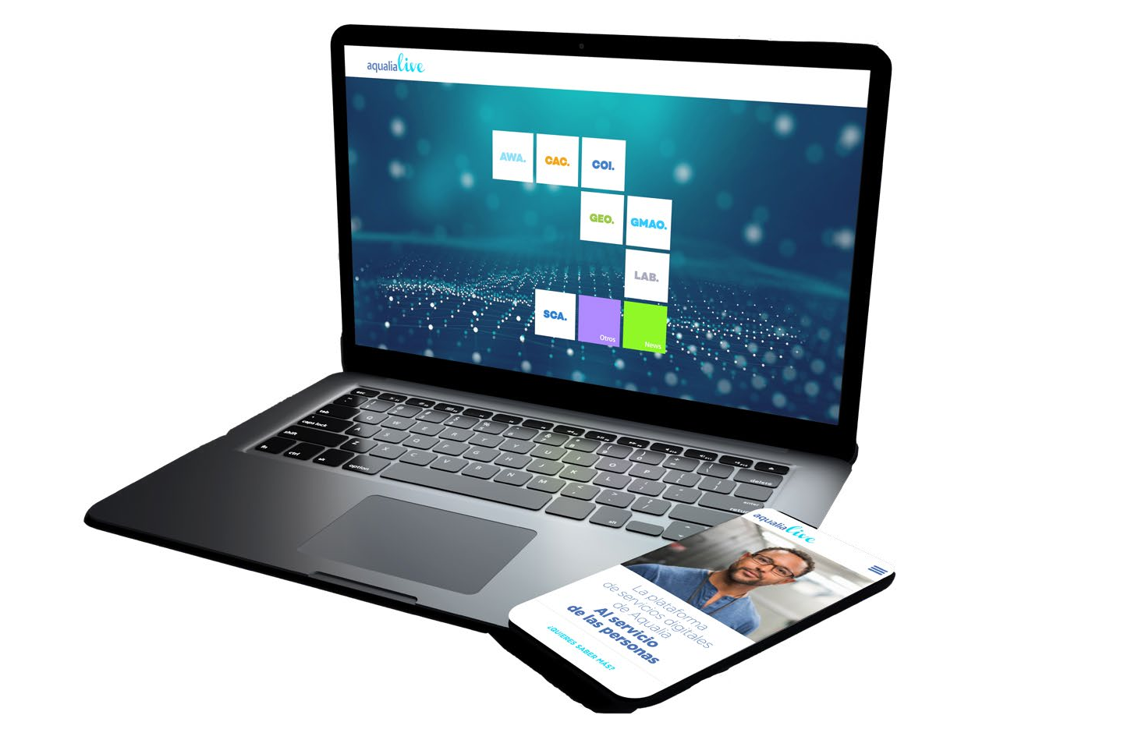


































































Aqualia
Digitalization of the end-to-end water cycle
Strategic Pillars
Value chain
Key figures
International presence
Business model
Values
Key objectives and challenges
Lines of action
References
Sustainability as a strategic driver
R&D&I strategy
Digitalization
The global platform that integrates all water management processes
AQUALIACONTACT
TRANSPARENCY AND OMNICHANNEL
Provides customers with access to contracts, invoices, and all types of management from anywhere.
Global commercial management of customers.
Reservoir
360° SUPERVISION
Everything is supervised from the COI. Facilitates real-time visualization of work.
1
Collection
Contact center for customer management
Updated network information on mobile devices before field intervention.
INSTITUTIONAL CLIENT
SMART METERS PARK
B
Irrigation in parks and gardens
6
2
Drinking water treatment
OT
WWTP
Reuse and return to nature
OT
A
C
DWTP
SUPPLY
SEWER
5
Wastewater Treatment
A
  Combustible biogas
  Sludge management for fertilizer.
  Energy efficiency.
EARLY LEAK DETECTION
Modeling. Supply and sewer networks.
4
Distribution and consumption
Overflow alerts and control of discharges into the environment.
B
WATER QUALITY
C
3
WATER QUALITY
Constant monitoring of water quality through planned sampling points.
Storage
BUILDING INFORMATION MODELING (BIM)
Combination of augmented reality and building information modeling for the end-to-end water cycle management.
OT

Slide 61








Aqualia
Digitalization: AqualiaLive Modules
Strategic Pillars
Value chain
Key figures
International presence
Business model
Values
Key objectives and challenges
Lines of action
References
Sustainability as a strategic driver
R&D&I strategy
Digitalization
Modules
Integrated Operations Centers for Sustainable Real‑Time Knowledge
They manage water networks, incidents, work order issuance, assets, regulatory maintenance, and meters in an integrated manner, increasing network sensorization, and enhancing plant monitoring and control.
Global Maintenance and Procurement Management
Manages service assets, plans and oversees maintenance activities, controls warehouse inventory, and carries out material purchasing and asset inventory management.
Continuous Network Monitoring
It enables the survey and georeferencing of network assets, allowing them to be clearly identified and supporting more accurate hydraulic modeling of the network.
Technology to Connect Customers
Provides proprietary, innovative solutions tailored to user needs, developed in line with best practices implemented across the industry.
Water Analysis for Intelligent Management
An analytical platform that collects and analyzes large volumes of data, transforming them into actionable knowledge to support intelligent decision‑making.
Supervision, Control, and Data Acquisition
Provides solutions for the needs of the water cycle by equipping users with the tools required to operate networks and any facility across the end-to-end water cycle.
Business Reporting and Descriptive Analytics Systems
An integrated dashboard providing key executive business indicators to support decision‑making.
Aqualia Laboratory
A platform composed of multiple modules that manages all aspects related to water quality.

Slide 62
Legal Notice
This document may contain forward-looking statements regarding the intentions, expectations, or forecasts of the FCC Group or its management as of the date of its issuance, which relate to various aspects such as the growth of different business lines, the results of the FCC Group, or other aspects related to its activity and situation.
These forward-looking statements or forecasts do not, by their very nature, constitute guarantees of future performance, being subject to risks, uncertainties, and other relevant factors that could cause the final developments and results to differ materially from those expressed in these intentions, expectations, or forecasts.
This document does not constitute an offer or invitation to acquire or subscribe for shares, in accordance with the provisions of Law 24/1988, of July 28, on the Securities Market, Royal Decree-Law 5/2005, of May 11, and/or Royal Decree 1310/2005, of November 4, and its implementing regulations.
The statements made in this declaration should be considered by all persons or entities that may need to make decisions or formulate or disseminate opinions regarding securities issued by the FCC Group. All are invited to consult the documentation and public information communicated or registered by the FCC Group with the National Securities Market Commission.
This document contains financial information that has been audited and prepared in accordance with International Financial Reporting Standards (IFRS).

